Slide 1

How to create and manage an ESR study in VCV
This guide for the Investigator explains how to create and manage a new ESR (Externally Sponsored Research) study in VCV.

Slide 2
How to use this guide
1
Click Accept
Numbered mulberry-coloured boxes describe the actions the user should carry out in sequence to complete the task.
Mulberry-coloured arrows identify odd-numbered actions, gold arrows identify even-numbered actions.
A pop-up box appears.
Grey boxes describe functionalities and explain what the user will see as they navigate the system.
Tips and reminders
Yellow boxes contain tips and reminders to help the user navigate the system more efficiently.

Slide 3
Contents and how to navigate these guidelines
1
How to create a Proposal
5
How to create an Amendment
How to provide Additional Information Requested
How to provide Final Deliverables
2
6
3
How to submit a Protocol
7
How to upload a document
How to provide a Project Status Update (PSU)
Any questions?
Links are clickable in slideshow mode
Use the Return to Contents link within each section divider to return to the Contents page at any time
4
8

Slide 4
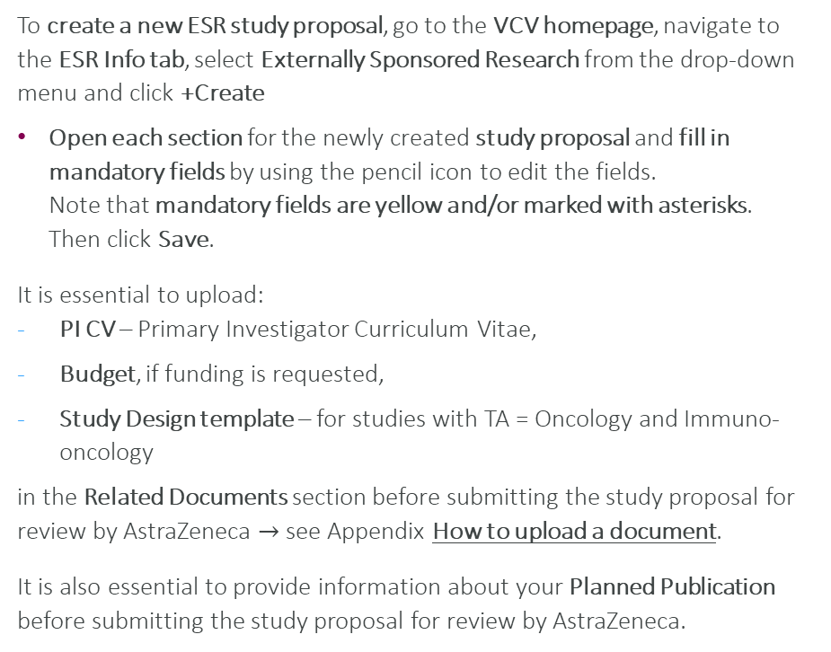
Introduction
To create a new ESR study proposal, go to the VCV homepage, navigate to the ESR Info tab, select Externally Sponsored Research from the drop-down menu and click +Create
Open each section for the newly created study proposal and fill in mandatory fields by using the pencil icon to edit the fields. Note that mandatory fields are yellow and/or marked with asterisks. Then click Save.
It is essential to upload:
PI CV – Primary Investigator Curriculum Vitae,
Budget, if funding is requested,
Study Design template – for studies with TA = Oncology and Immuno-oncology
in the Related Documents section before submitting the study proposal for review by AstraZeneca $→$see Appendix How to upload a document.
It is also essential to provide information about your Planned Publication before submitting the study proposal for review by AstraZeneca.
Once an ESR study proposal has been created and submitted to AstraZeneca, it undergoes QC (Quality Check) and Review
Depending on the Verdict of the Proposal Review, the Investigator may receive a task: Additional Information Requested
Once Proposal Review is completed, the Protocol must be submitted
Depending on the Verdict of the Protocol QC (Quality Check) and Review, the Investigator may receive a task: Additional Information Requested
Once the study is underway, it will be necessary for the Investigator to provide Project Status Updates
The Investigator may need to create an Amendment and update the Study Design template document if the design has changed (applicable for Oncology and Immuno-Oncology studies)
When the study is Closing, the Investigator will need to provide Final Deliverables (if applicable)
The steps for each of these tasks are included in this How To guide.

Slide 5
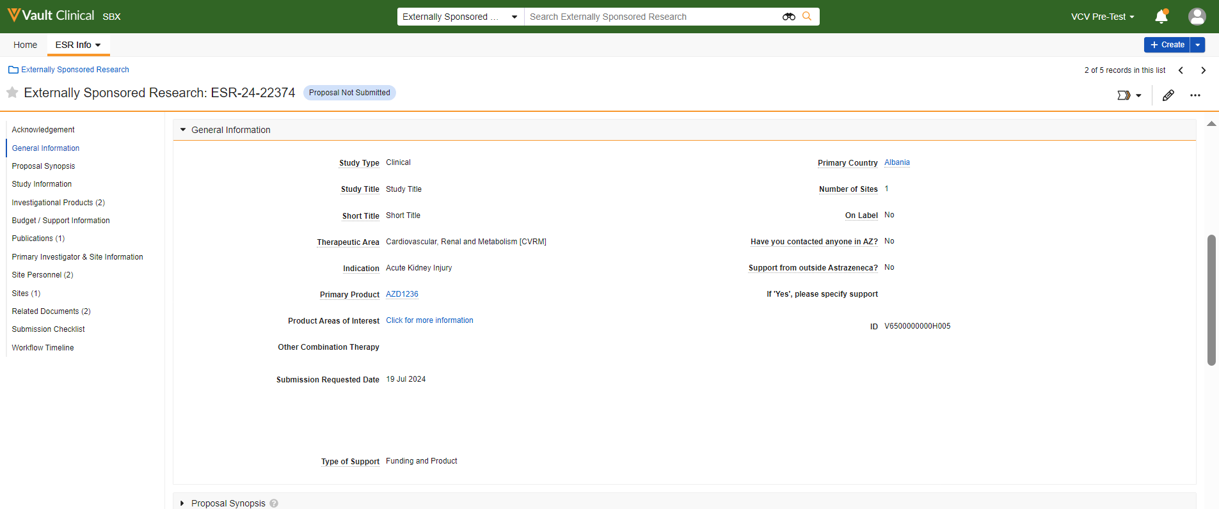


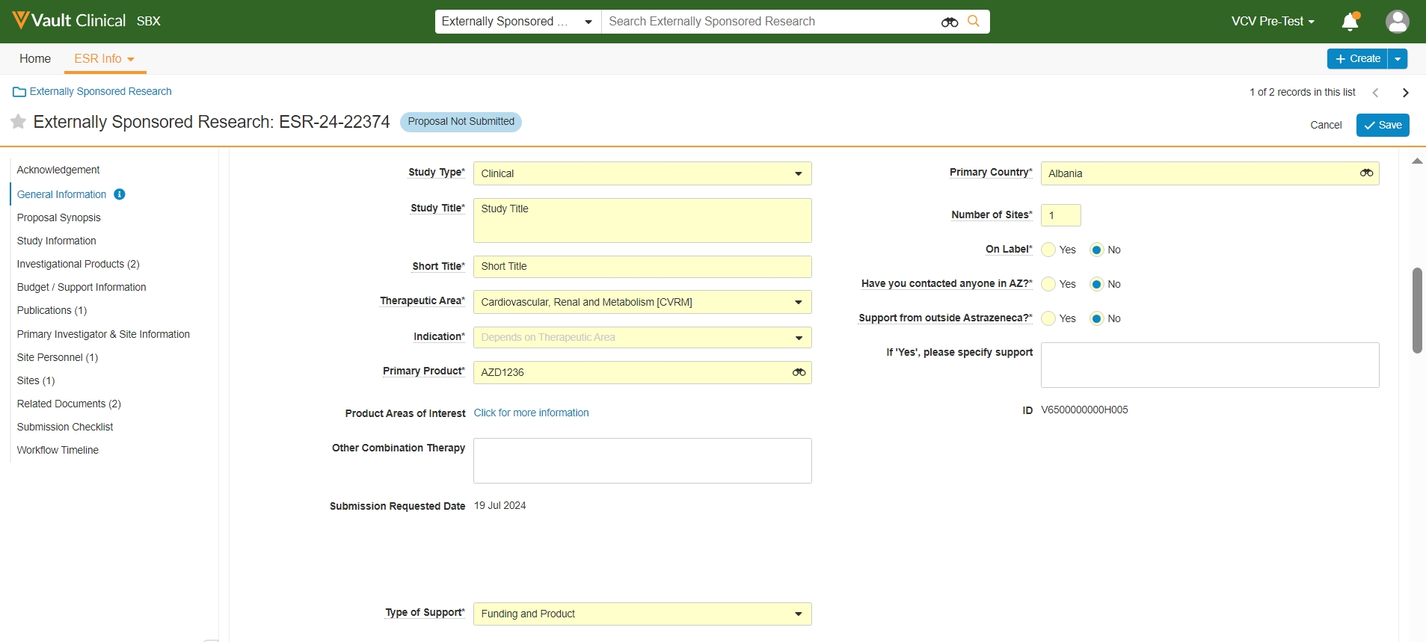

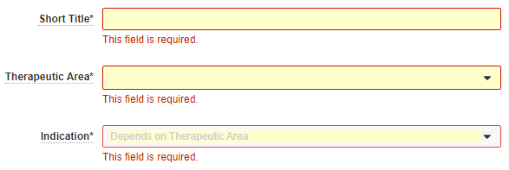
System Navigation Instructions
To provide or edit information in the study section or record, click on the pencil icon top right
Mandatory fields are highlighted in yellow and/or marked with asterisks.
Please note: Before moving on to the next sections, remember to click Save each time after editing the fields in a specific section or record.
Required fields will display in red if the user does not fill them out before clicking Save.

Slide 6
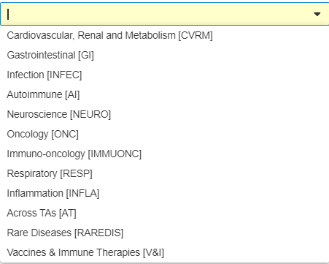
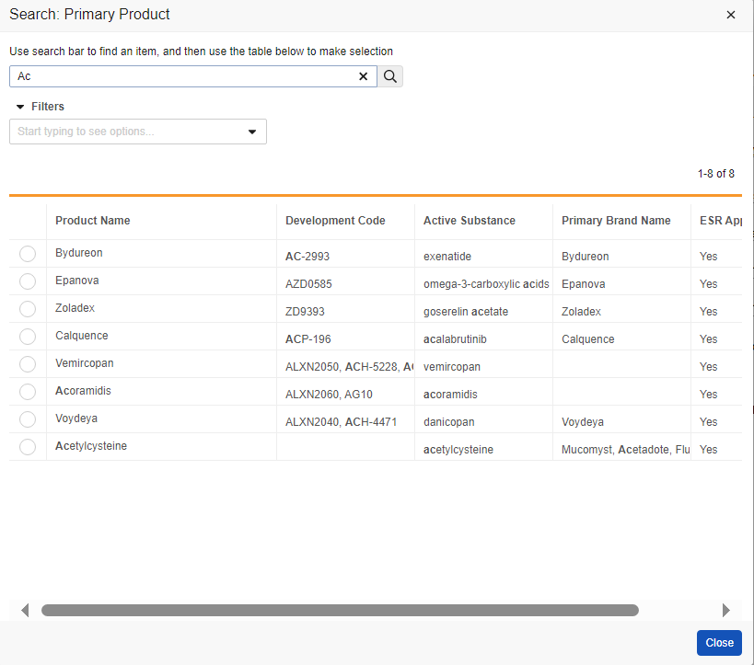
System Navigation Instructions
Clicking on the fields with an arrow displays a dropdown list, allowing you to select the preferred option, e.g., Therapeutic Area or Type of Support.
In certain fields, e.g., Primary Product, there is a binoculars icon. Clicking the icon will cause a pop-up Search box to appear, providing more options to complete the field.
Select an item and click Close to populate the field with the chosen item. Fill in the remaining fields and click Save

Slide 7
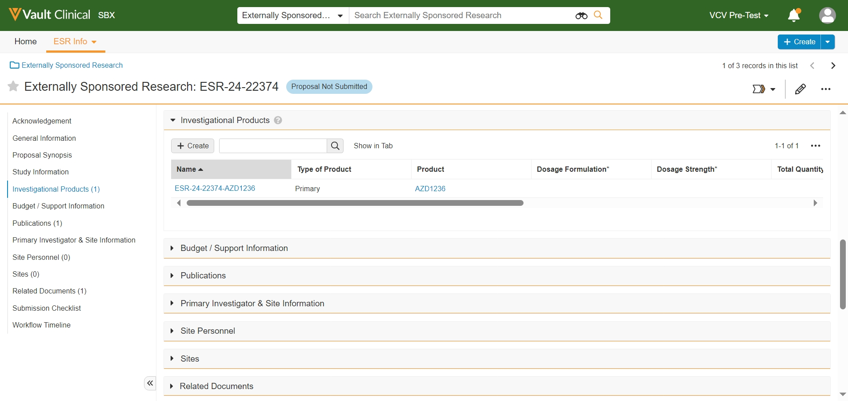

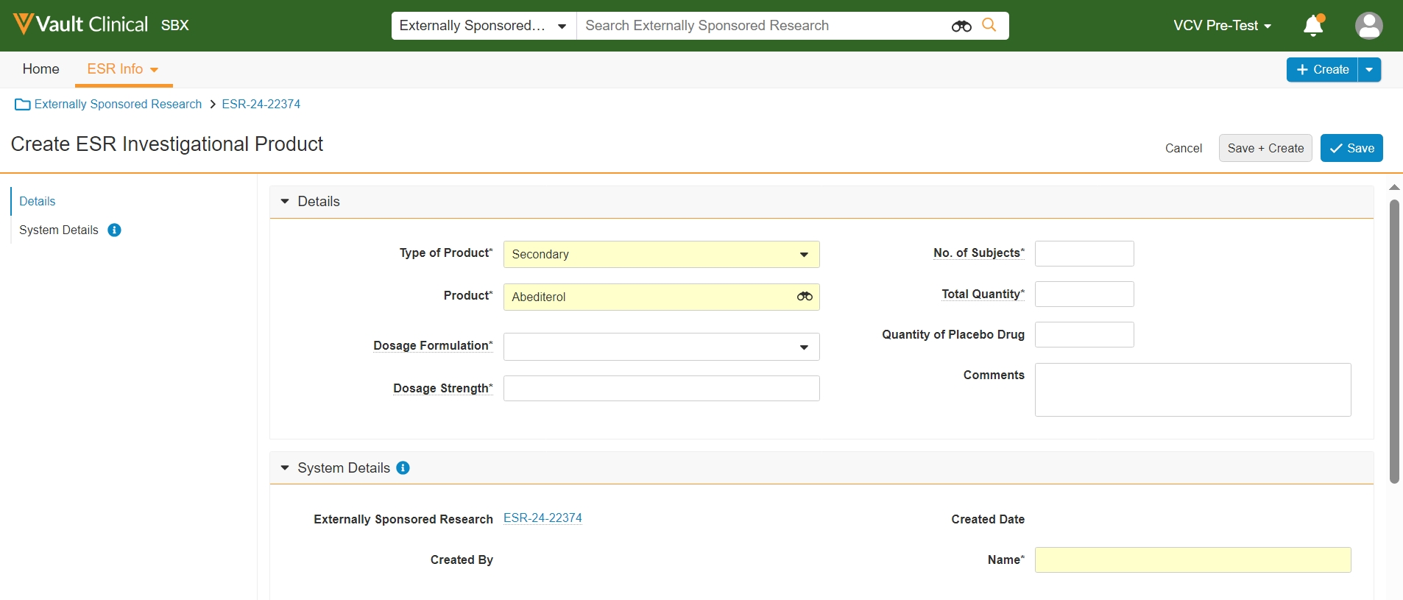

System Navigation Instructions
In some sections, such as Investigational Products, multiple records can be created by clicking +Create
A pop-up window appears:
Create ESR Investigational Product.
Fill in the mandatory fields and click Save
Hovering a cursor over the field name underlined with dots will show additional instructions for the field.

Slide 8
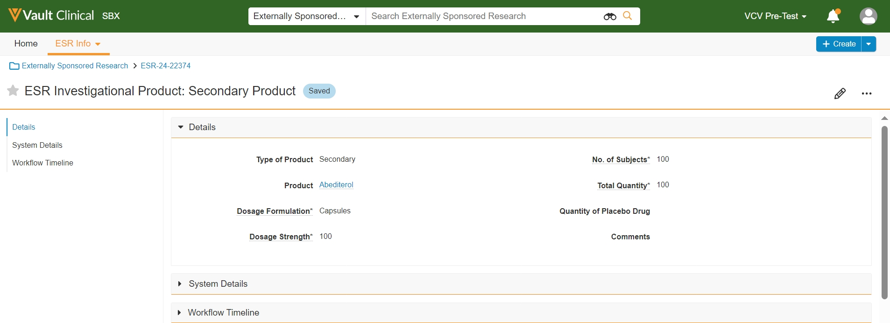
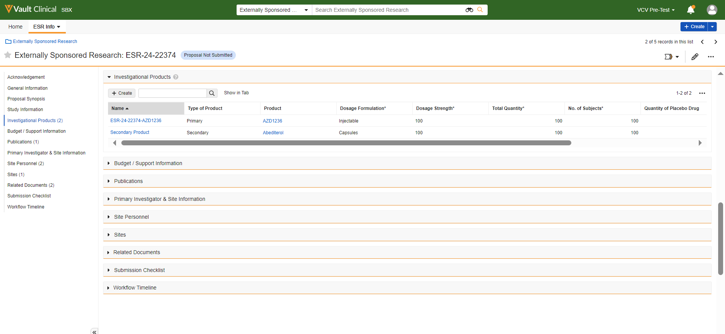
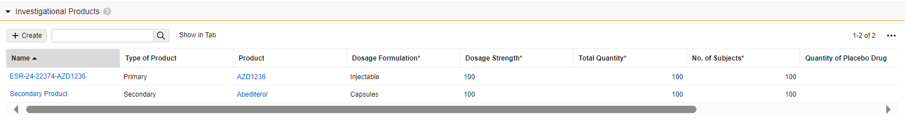
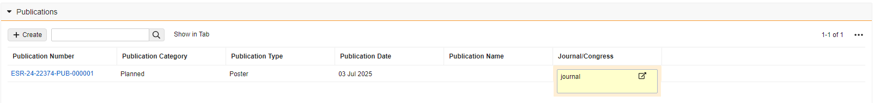
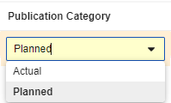
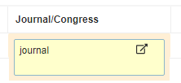
System Navigation Instructions
Clicking Save will cause a new window to appear, displaying the created record details. To edit its information, follow these instructions.
Click on the ESR Number top left to go back to the Study view
Created record appears under its respective section. Clicking the record Number will open the previous window with record’s information.
Certain fields can be updated directly in the table view by double-clicking on them. To Save changes, click anywhere outside the edited field.
Please note: Use this feature only for individual field updates to avoid missing important record details.

Slide 9
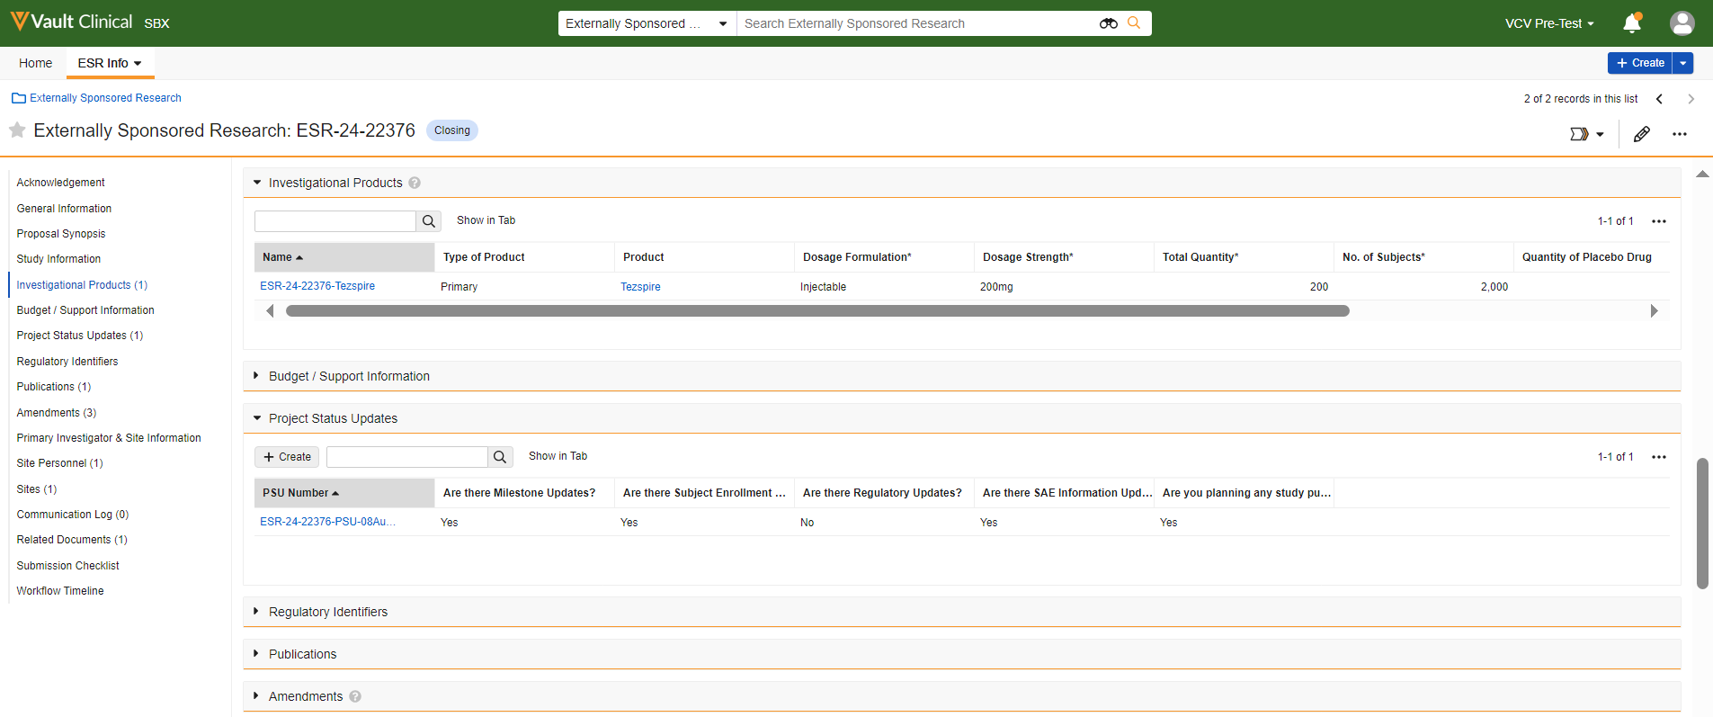
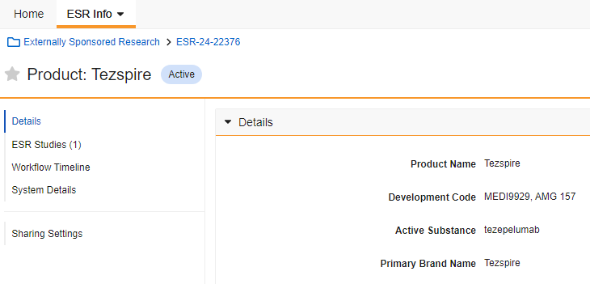

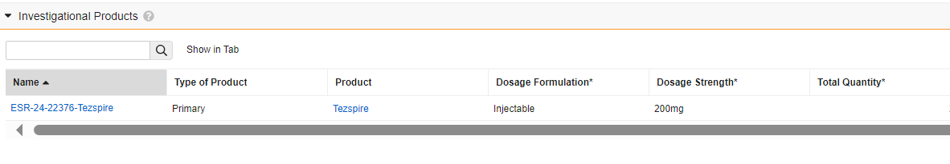
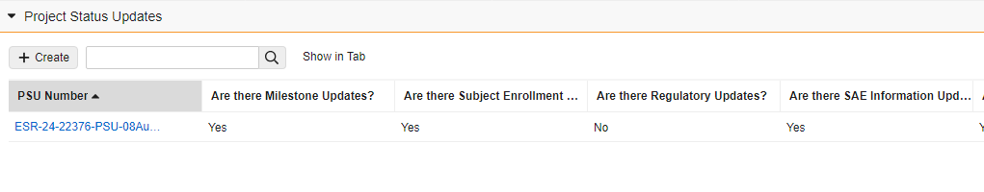
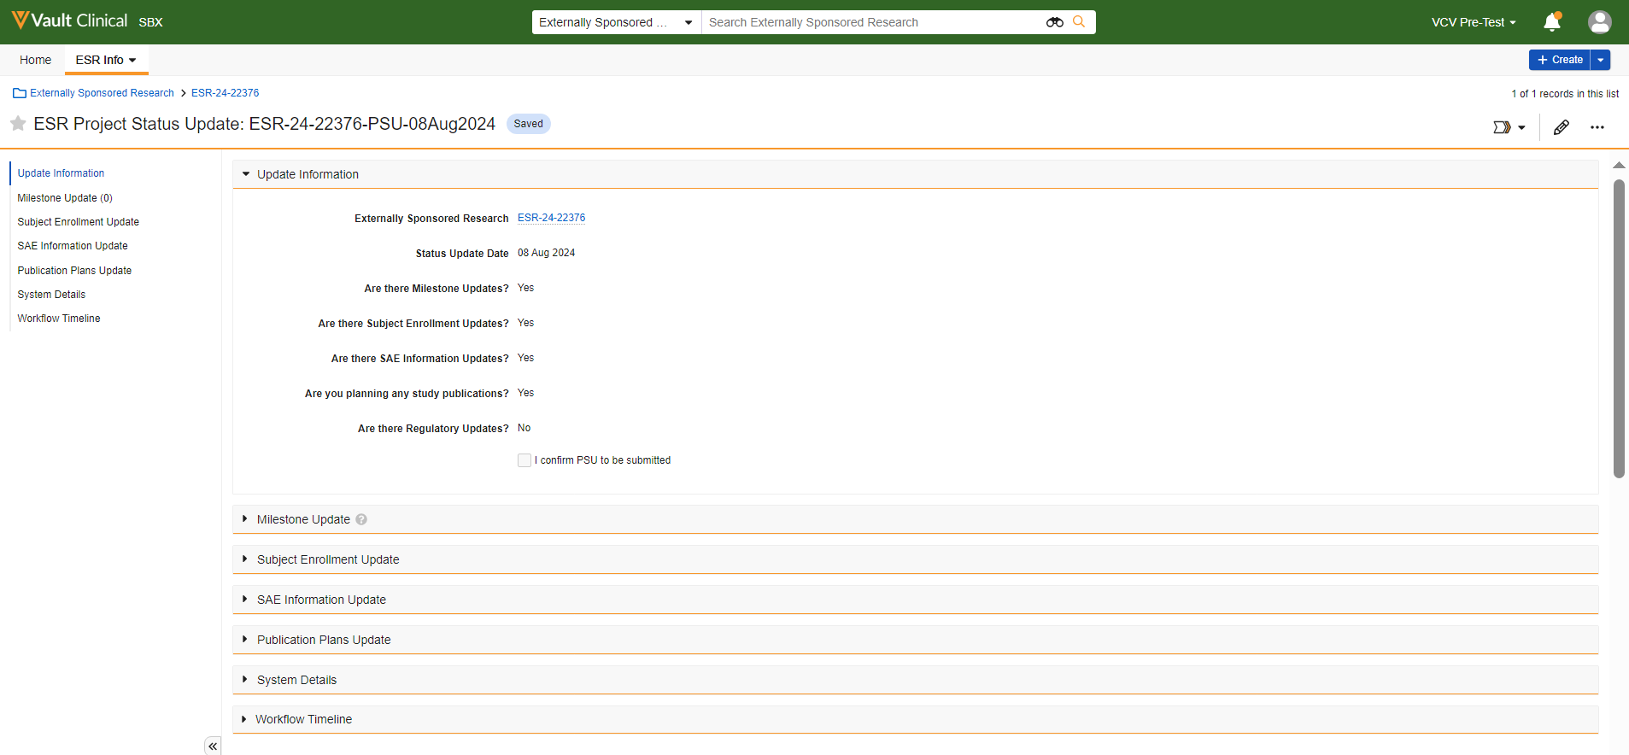
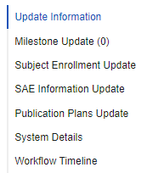
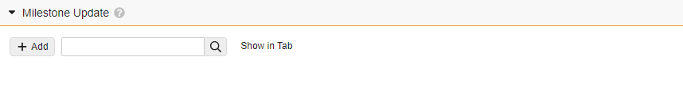
System Navigation Instructions
Blue-link objects in VCV e.g., Product are clickable and can be opened to see their details.
However, unlike created records, the object information cannot be edited.
Objects or records may have sub-sections that are not accessible from the Study view and can be seen after clicking on a specific object or record number e.g., Project Status Update.
In certain sub-sections, objects and/or documents can be added. They will only appear in a specific record’s subsection.

Slide 10


How to create a Proposal
1
Click the link to see the training video,
How to create a proposal
Return to Contents

Slide 11



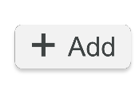


Overview – How to create an ESR study proposal
1
9
Log in to VCV
On the Homepage, click ESR Info tab and select Externally Sponsored Research. Click +Create top right.
Open the Publications section.
Complete the mandatory fields:
10
Open the Primary Investigator & Site Information section. Complete the mandatory fields:
Note: At least one planned publication is mandatory.
Publication Category
Publication Type
Publication Date
Journal/Congress
Note: Once the information is added, it will automatically appear in the Site Personnel and Sites sections. Additional personnel and sites can then be added to those sections.
Primary Investigator (External) – a pop-up Search box will show up, but a new record must be created if the name is not included in the list
Primary Site (External) – a pop-up box will show up
2
Please review AstraZeneca’s Terms and Conditions in the Acknowledgements section, then select ‘I agree with the statement above’ to confirm your acceptance.
8**
Open the Budget/Support Information section and complete the mandatory fields:
3
Study Type
Study Title
Short Title
Therapeutic Area
Indication
Tumor Type (Oncology studies)
Primary Product
Type of Support
Primary Country
Number of Sites
On Label
Have you contacted anyone in AZ?
Support from outside AstraZeneca?
11
Open the General Information section and complete the mandatory fields:
Requested Currency
Total Amount Requested
Open the Related Documents section.
To add mandatory PI CV and Budget, click +Add. When the pop-up box shows up, click Create and follow steps to upload and identify the documents required.
7*
Note: To complete this and the following sections, utilise the pencil icon at the top right to access the fields and click Save once you have finished entering the information.
Open the Investigational Products section and complete the sub-section mandatory fields:
12
The Submission Checklist enables you to ensure that all required documents are included. To check the boxes, you must first click the pencil icon.
Primary product is automatically created in the Investigational Products section.
Product
Dosage Formulation
Dosage Strength
No. of Subjects
Total Quantity
4
Once the above fields have been completed and saved, a unique study number is generated, and the study transitions to the ‘Proposal Not Submitted’ lifecycle state, allowing more sections to be filled in.
6
13
Open the Study Information section and complete the mandatory fields:
Go to the workflow icon top right and select Submit Proposal from the drop-down menu.
Primary Objective
Secondary Objectives
Primary Endpoint
Secondary Endpoint
Inclusion Criteria
Exclusion Criteria
Hypothesis
Rationale
Population
Sample Size Justification/Statistical
Treatment regimen
Contract Execution to FSI (in months)
FSI to 50% Enrollment (in months)
50% Enrollment to LSI (in months)
LSI to LSLV (in months)
LSLV to FSR (in months)
Design Characteristics
Study Phase
Blinding
Randomisation
Safety Listings required?
Are there Additional Countries?
Study Design template
Planned No. of Enrolled
Planned No. of Entered Treatment
Planned No. of Completed
Note: If any mandatory information is missing, an error message will list the missing items.
5
Open the Proposal Synopsis section and complete the mandatory fields:
14
During the Proposal in Review lifecycle state, AstraZeneca will notify you if additional information is required for the study.
* This section is only applicable when the Product is requested
** This section is only applicable if funding is requested

Slide 12
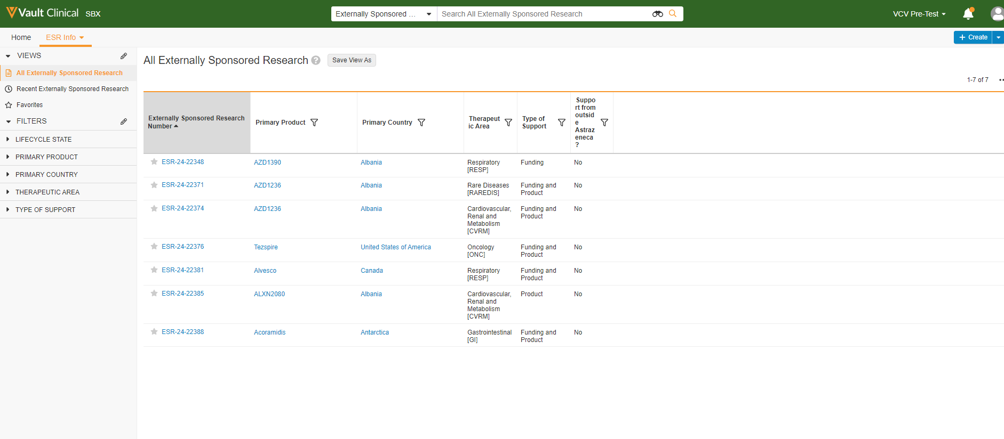

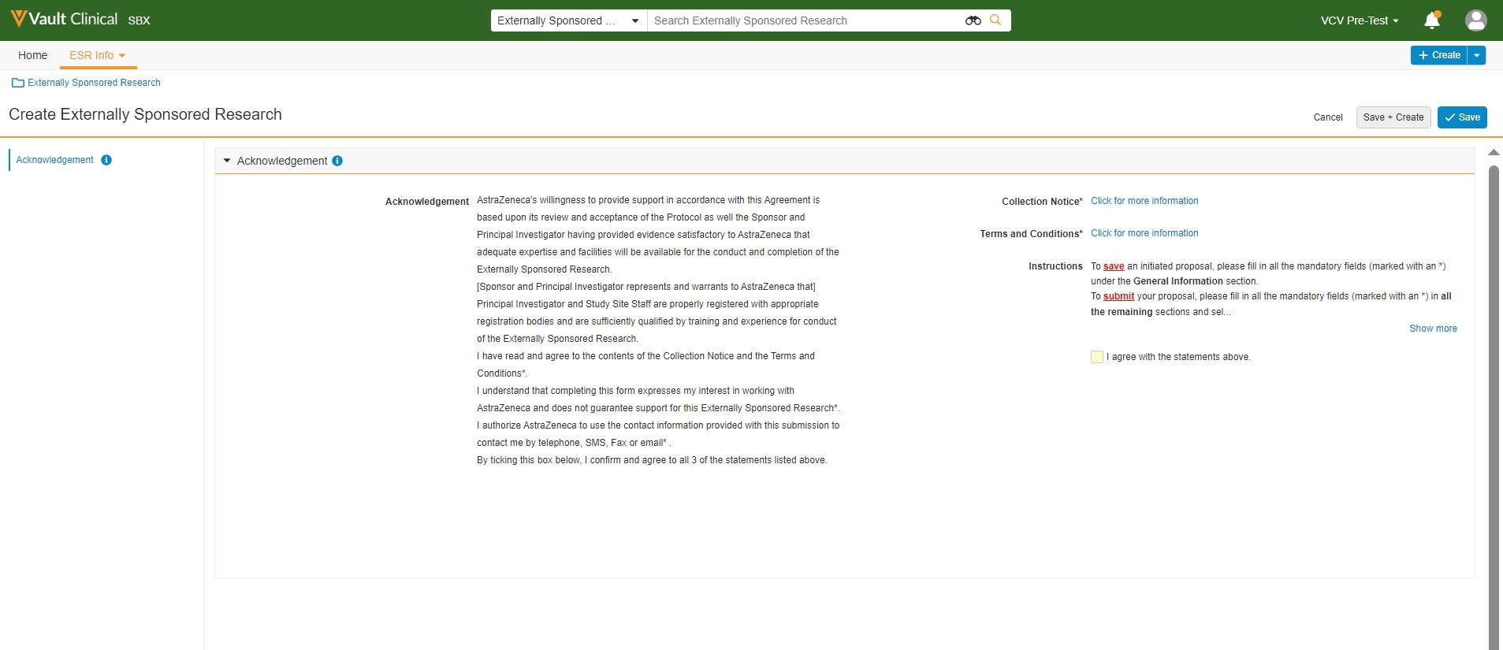
VCV Walkthrough - How to create an ESR study proposal
Externally Sponsored Research creation
1
To create an ESR study proposal, click on the ESR Info tab and select Externally Sponsored Research
2
Click +Create top right
A new window appears: Create Externally Sponsored Research
If you have previously created or been assigned to a study, all related Externally Sponsored Research can be seen in the ESR Info Tab. All your ESR studies with their numbers will be visible in blue in the left-hand column on your screen.

Slide 13

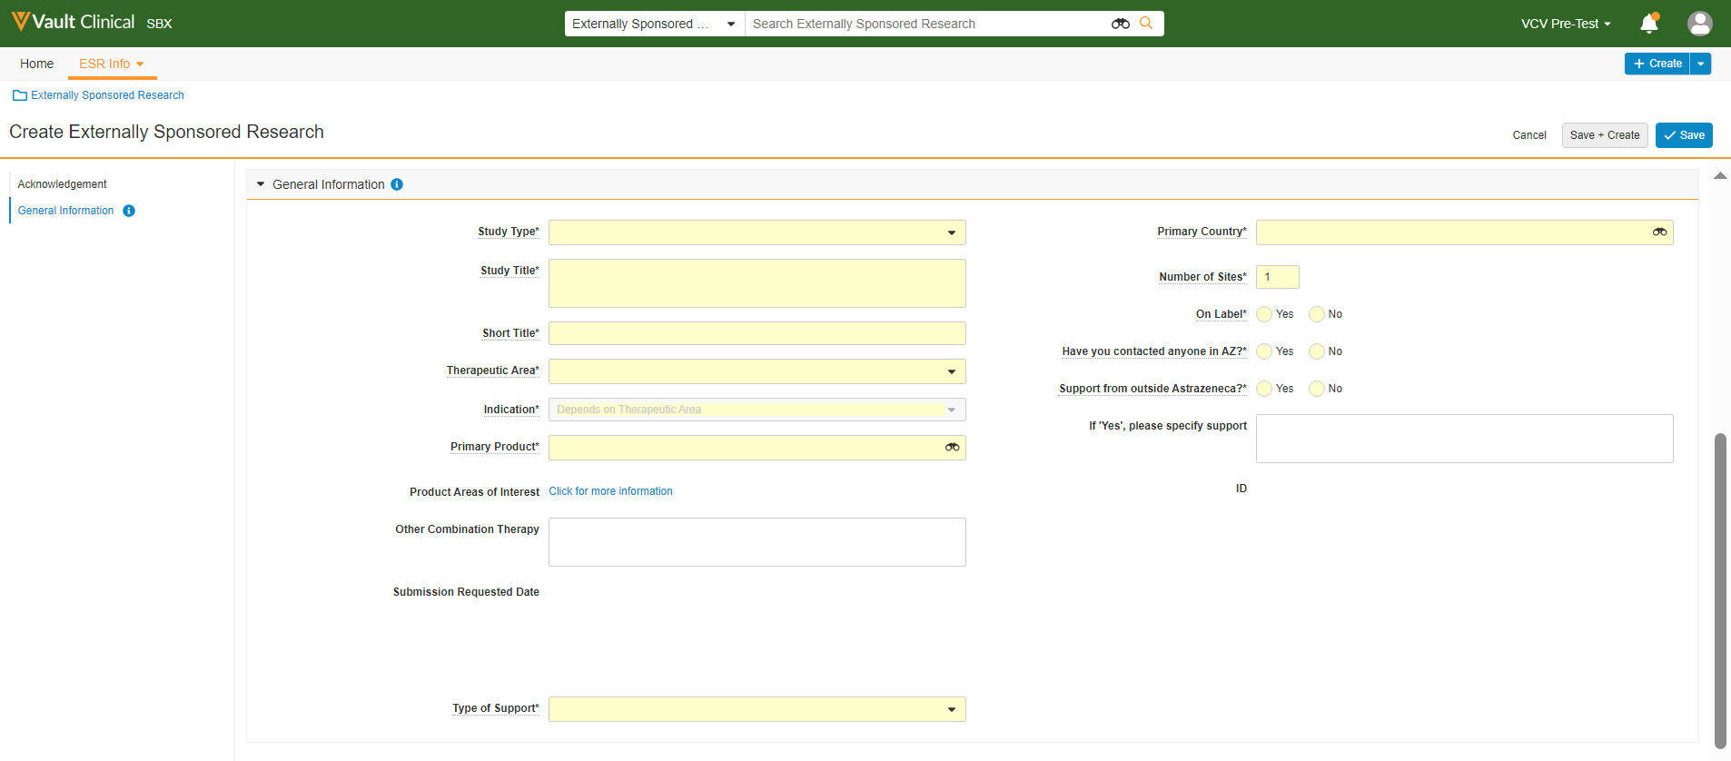

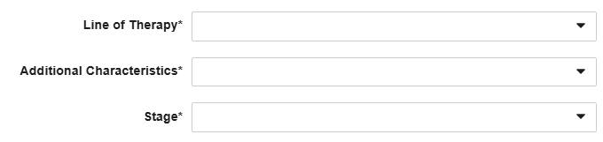
VCV Walkthrough - How to create an ESR study proposal
Acknowledgement / General Information sections
3
Read and ensure you understand information in the Acknowledgement section
Then, check the box 'I agree with the statements above'
When the box is checked, the General Information section appears with mandatory fields that must be completed before the draft ESR proposal can be saved.
4
Complete the mandatory fields under the General Information section
ONC
If the selected Therapeutic Area is Oncology or Immuno-oncology, new mandatory fields appear and need to be completed before saving the proposal.
ONC
Step completed for Oncology/Immunooncology ESRs

Slide 14
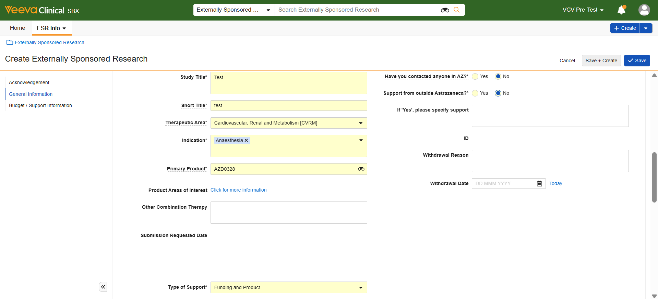

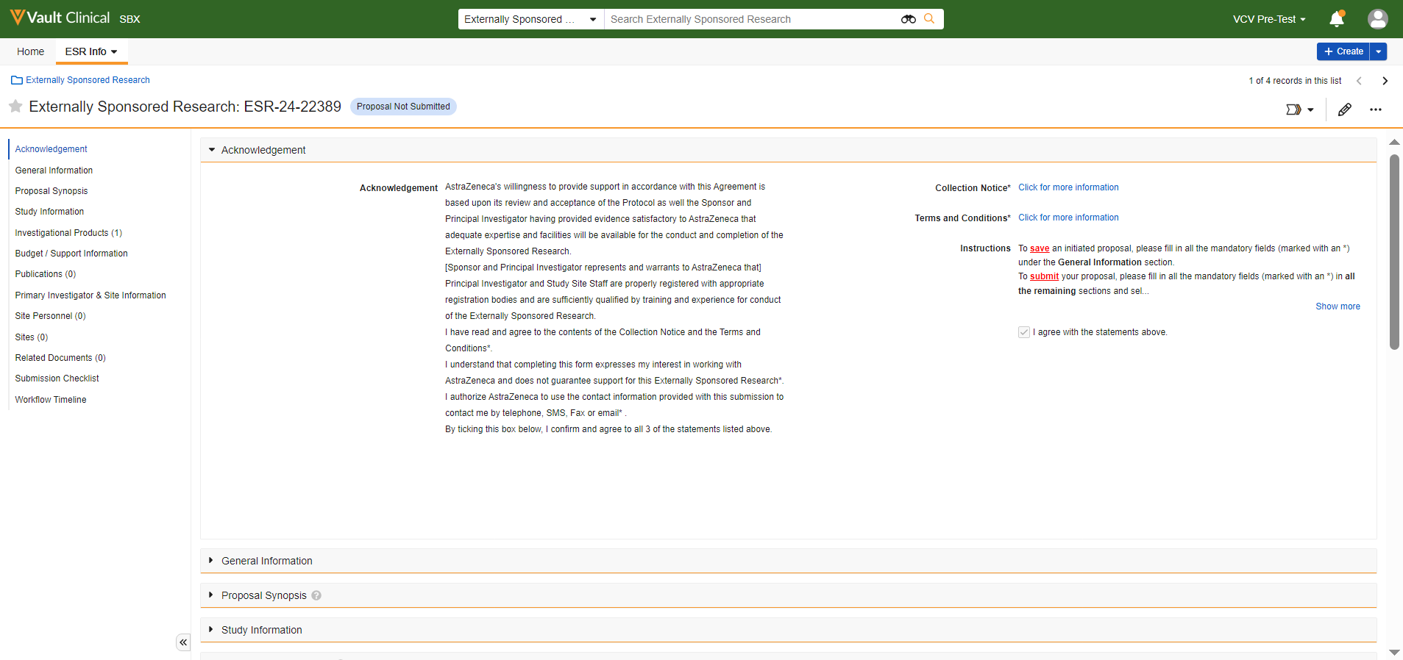
VCV Walkthrough - How to create an ESR study proposal
Proposal Not Submitted
5
Click Save
Saving an initiated proposal prompts the main view of the Study to appear, with a unique ESR number assigned to this study.
Lifecycle of the Study shows as Proposal Not Submitted. Further sections are visible and require completion.
Follow instructions on the next slides to prepare your Study Proposal for submission.

Slide 15
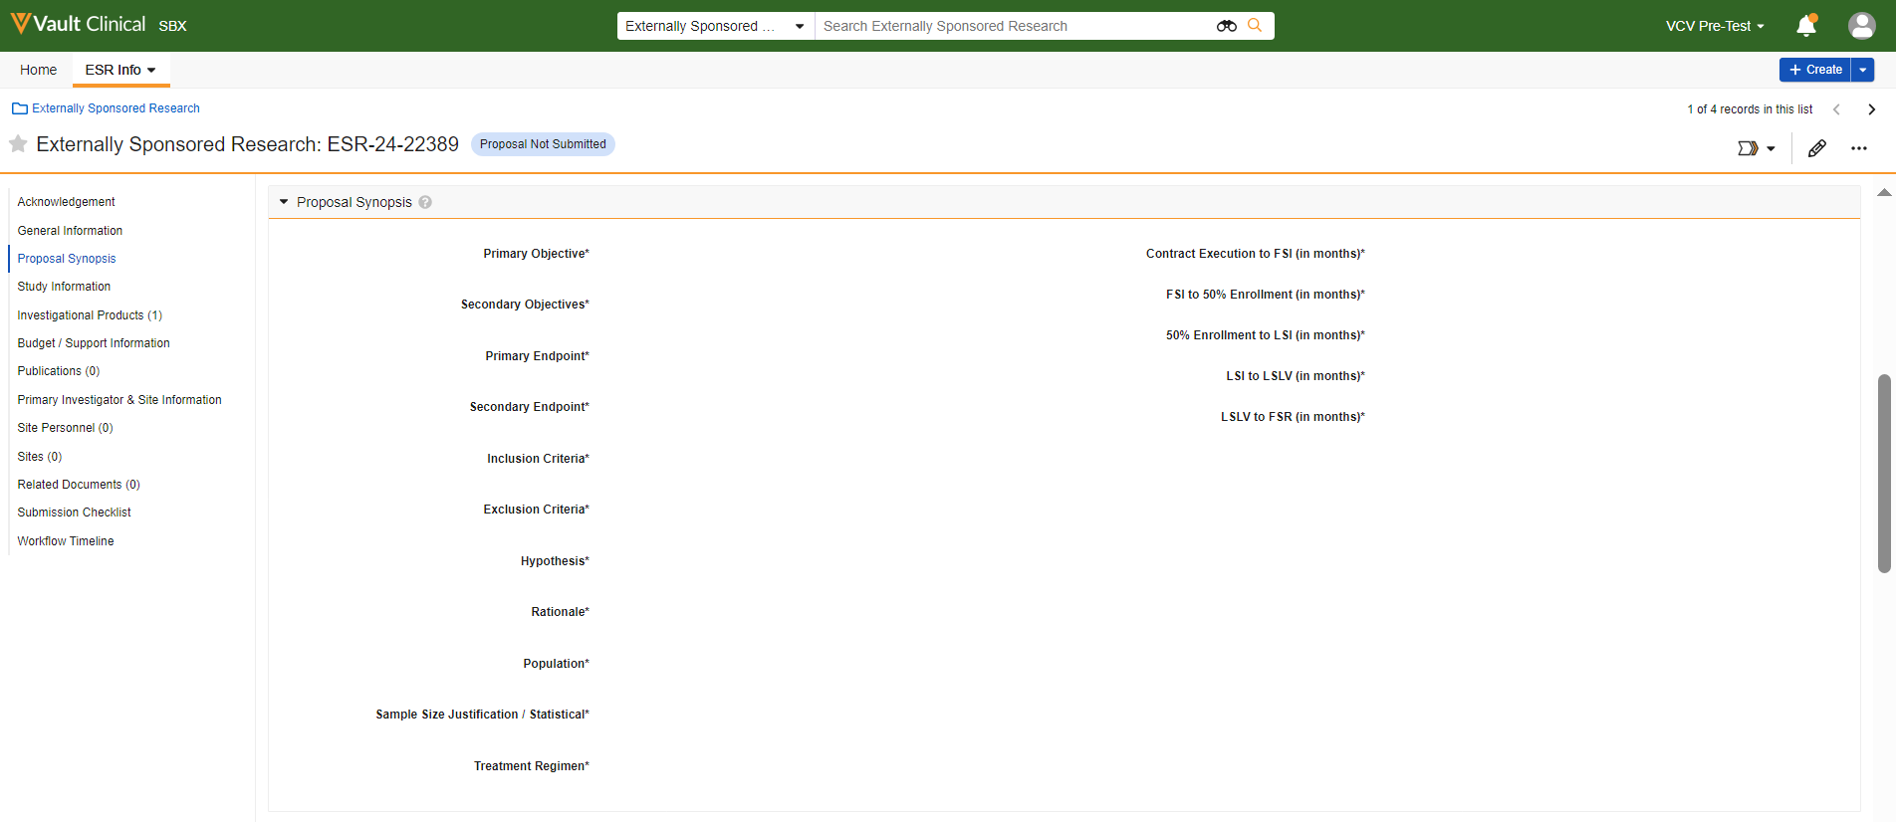

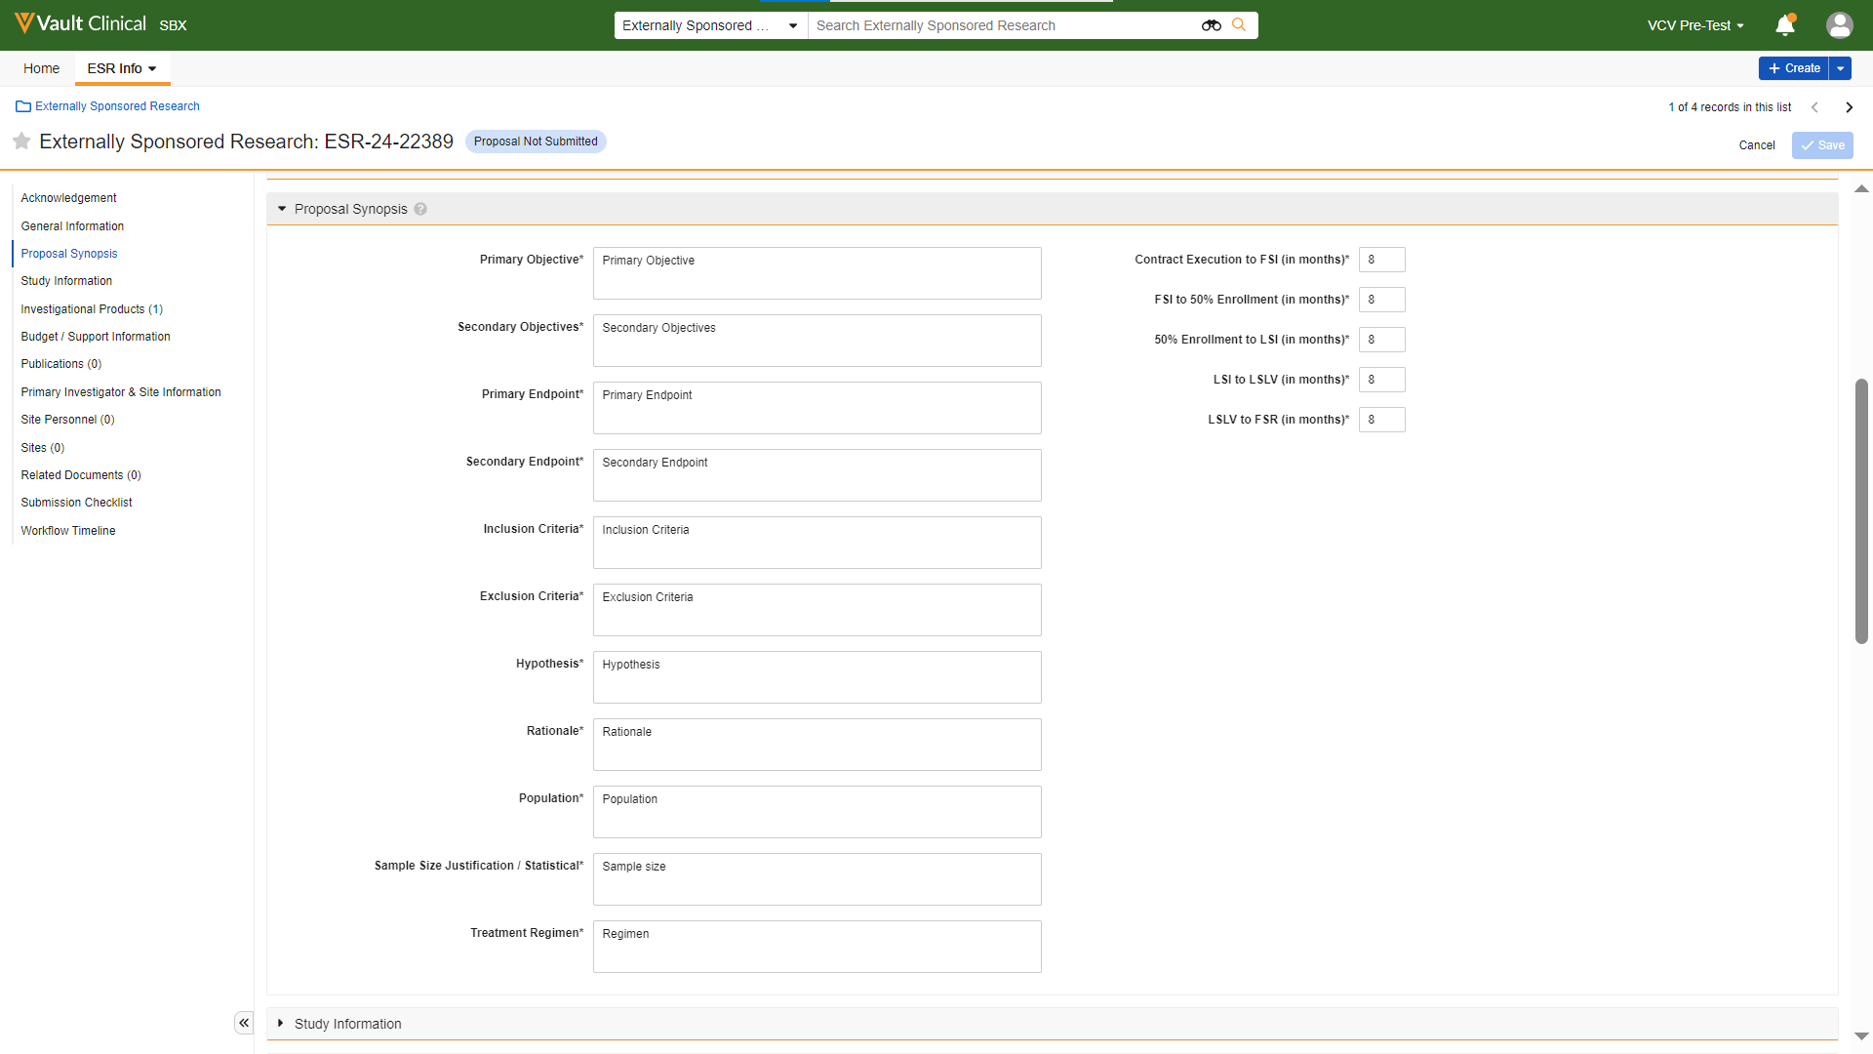
VCV Walkthrough - How to create an ESR study proposal
Proposal Synopsis section
6
Open the Proposal Synopsis section and click on the pencil icon top right
7
Complete the mandatory fields and click Save

Slide 16
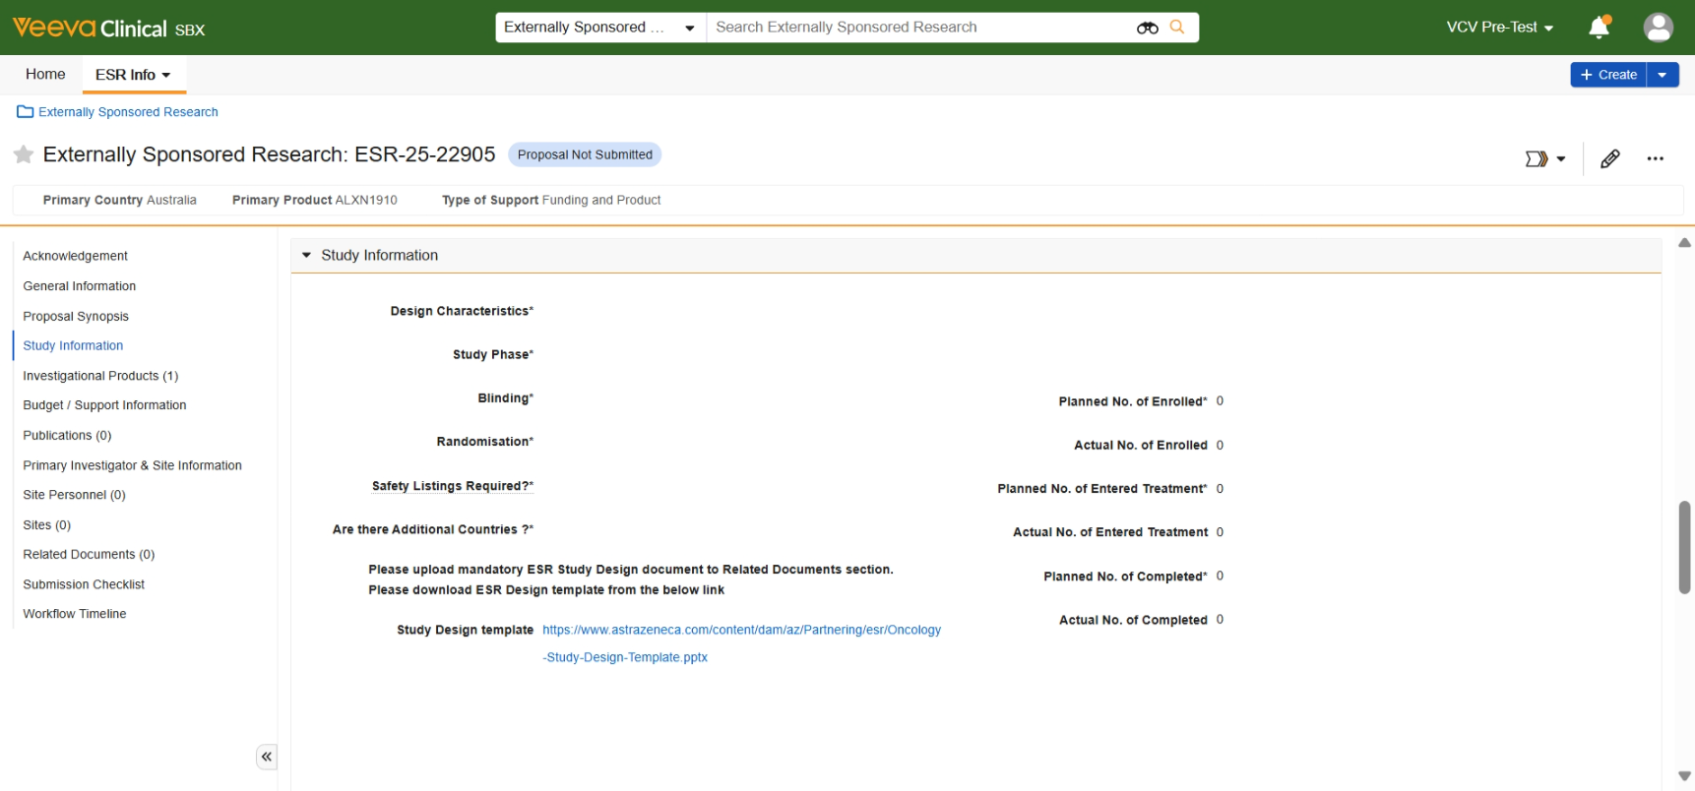
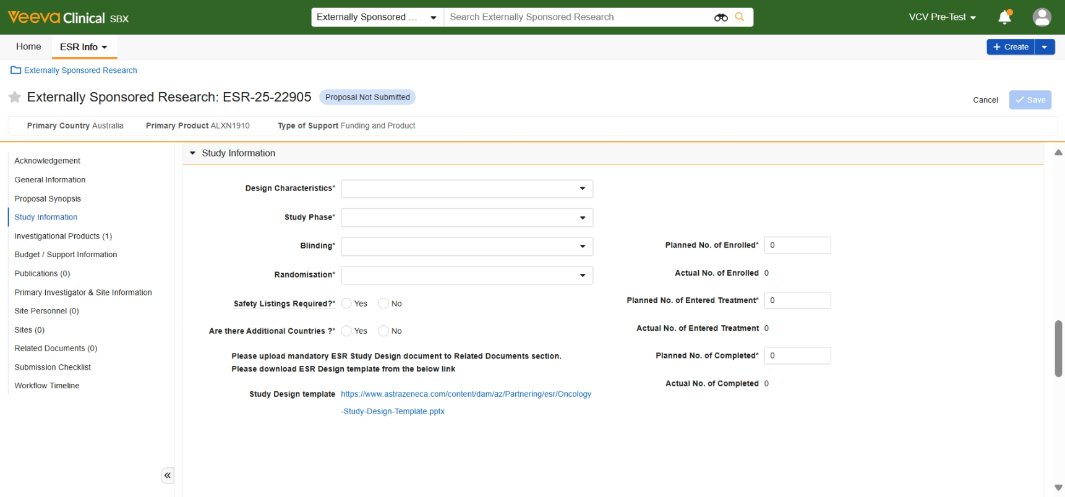

VCV Walkthrough - How to create an ESR study proposal
Study information section
8
Open the Study Information section and click on the pencil icon top right
When TA = Oncology or Immuno-oncology, the Study Design template document will be linked in the Study Information section. Upon submitting a proposal, external user is required to download the template, fill it in and upload the design into the Related Documents section under the document subtype: Study Design (see Appendix → How to upload a document).
9
ONC
Click the link to download ESR Design template, fill in the document and upload it to Related Documents section
10
Complete the remaining mandatory fields and click Save
ONC
Step completed for Oncology/Immunooncology ESRs

Slide 17
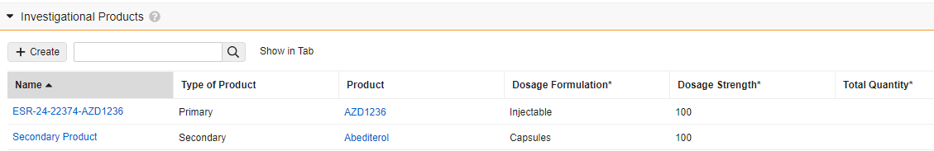
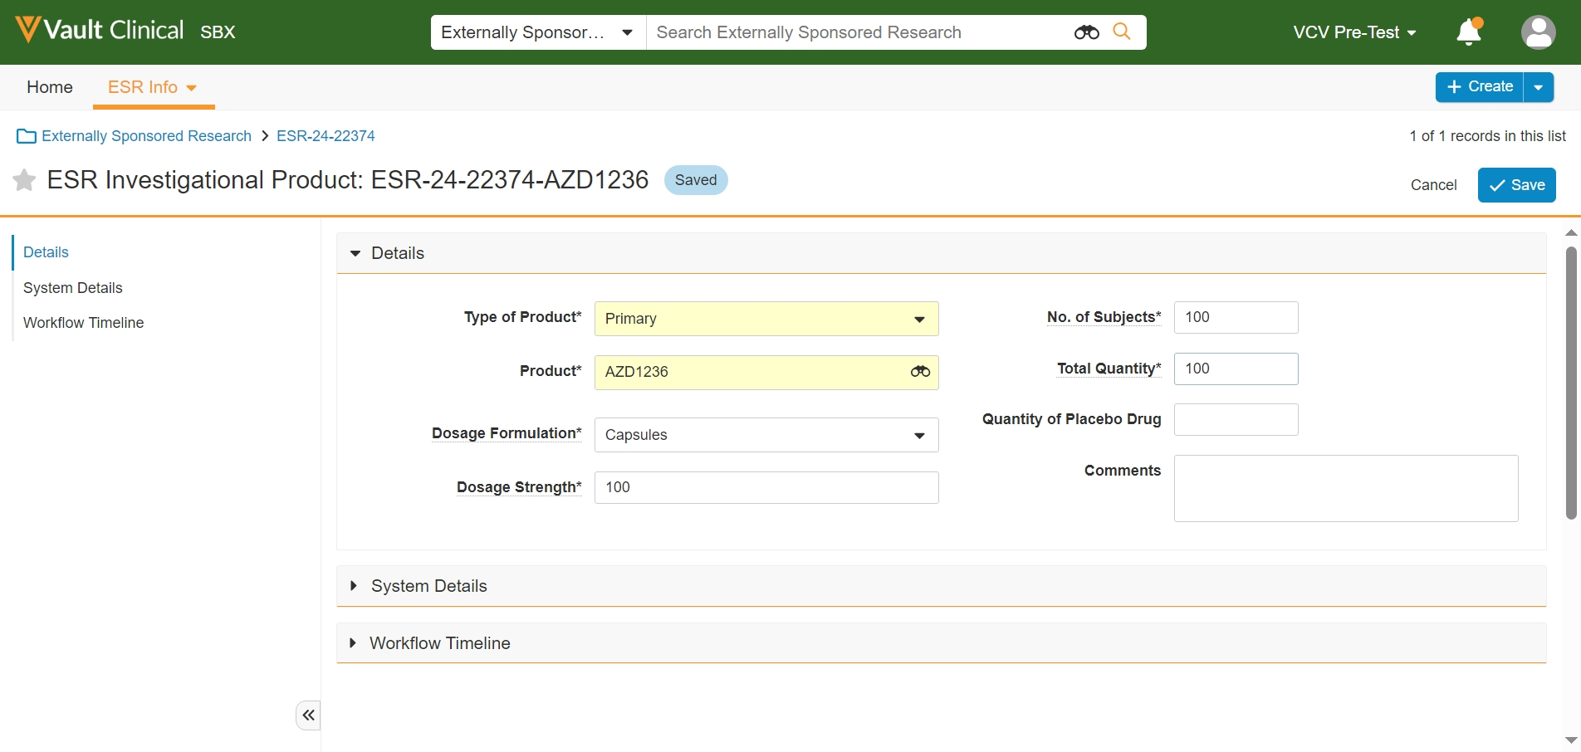

VCV Walkthrough - How to create an ESR study proposal
Investigational Products section
11
Open the Investigational Products section
The Primary Product record is automatically created based on information from the Primary Product field in the General Information section. However, not all required fields are filled in and must be populated manually.
12
Click on the record Number to open and review its details
13
Complete the required fields and click Save

Slide 18

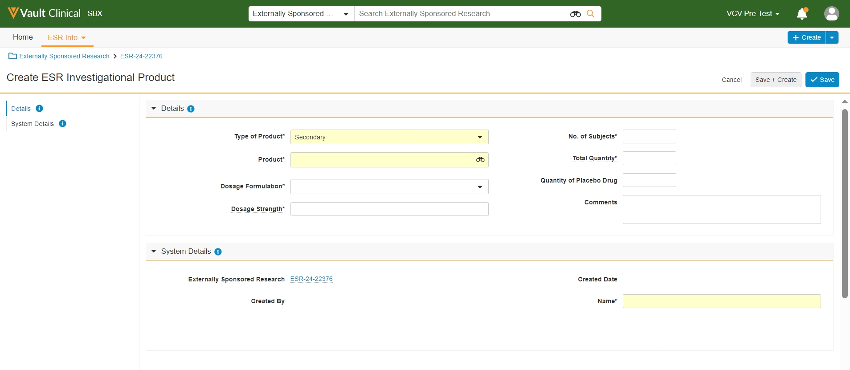
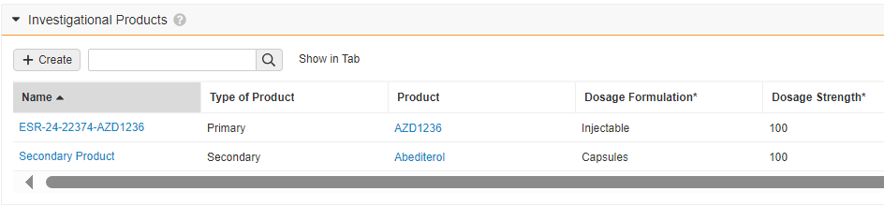
VCV Walkthrough - How to create an ESR study proposal
Investigational Products section
14
To add secondary product, click +Create under the Investigational Products section
15
Complete the mandatory fields and click Save
Created Product appears in the Investigational Products section.

Slide 19
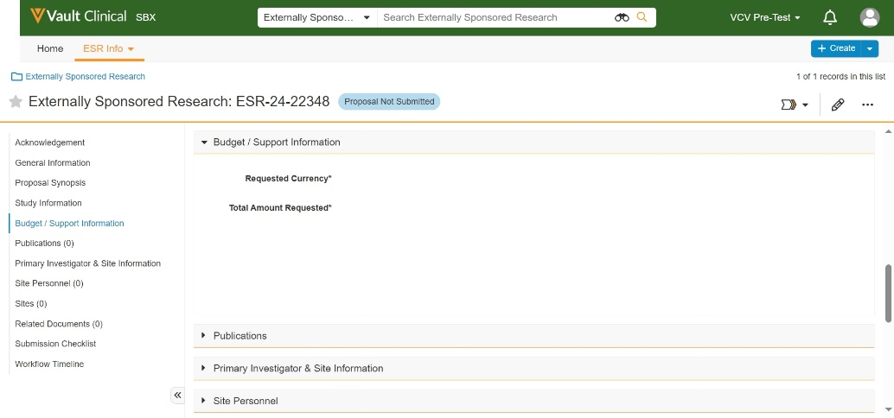
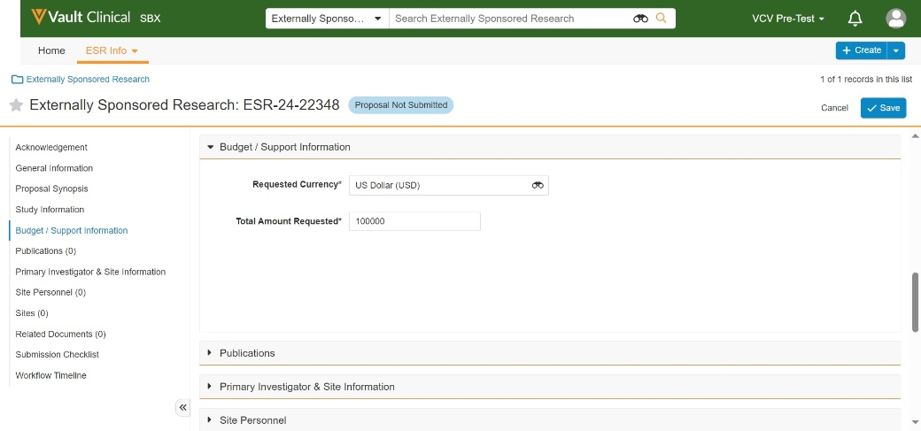
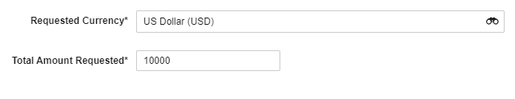
VCV Walkthrough - How to create an ESR study proposal
Budget / Support Information section
16
Open the Budget/Support Information section and click on the pencil icon
17
Complete the mandatory fields and click Save
If the selected Type of Support is NOT Funding or both Funding and Product, go to step 18.

Slide 20
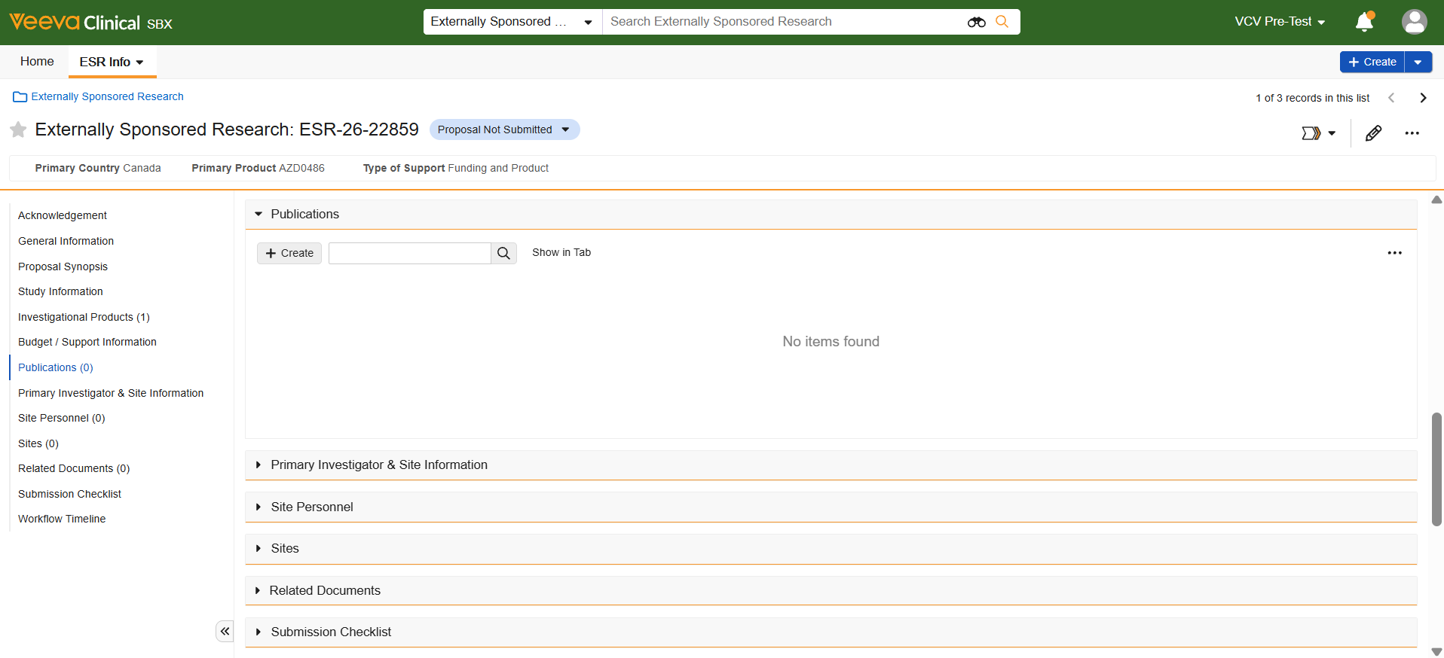

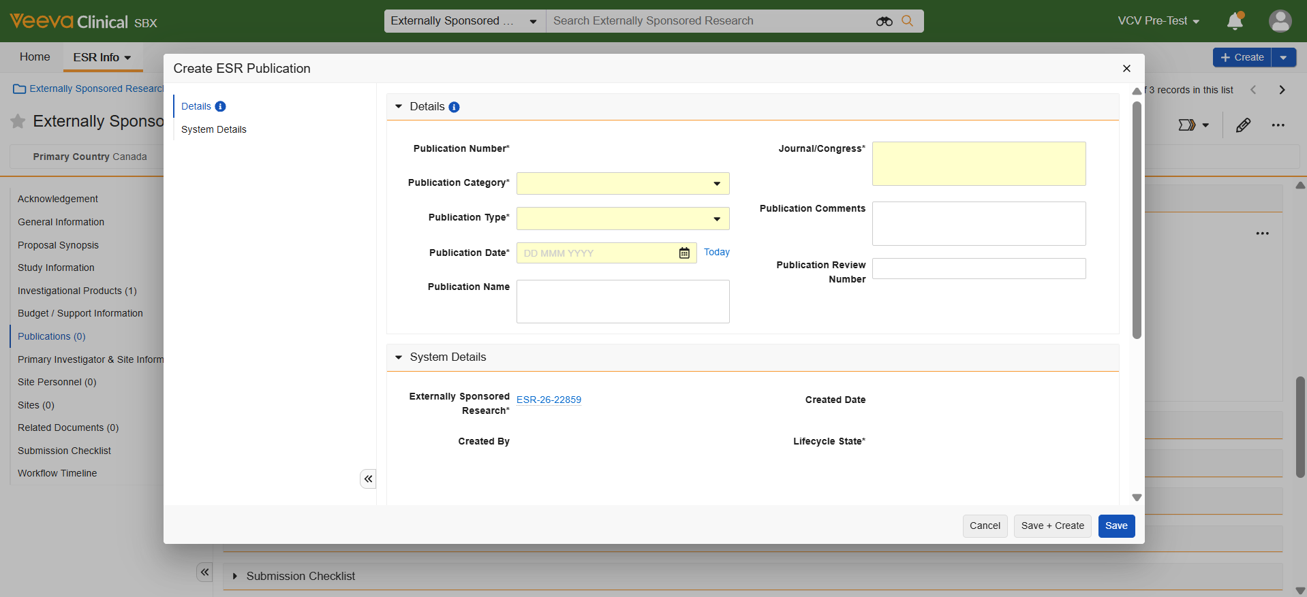
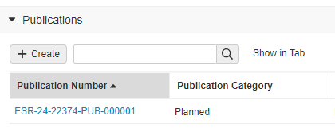
VCV Walkthrough - How to create an ESR study proposal
Publications section
18
Open the Publications section and click +Create to add a planned publication
A pop-up window appears: ​ Create ESR Publication.
19
Fill in the mandatory fields and click Save​
Publication record appears in the Publications section.​

Slide 21
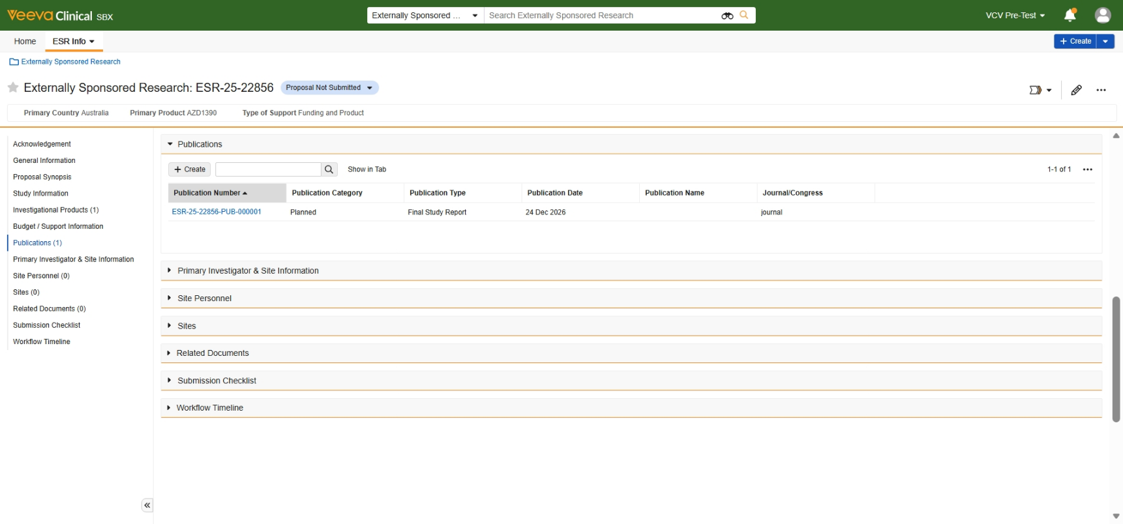
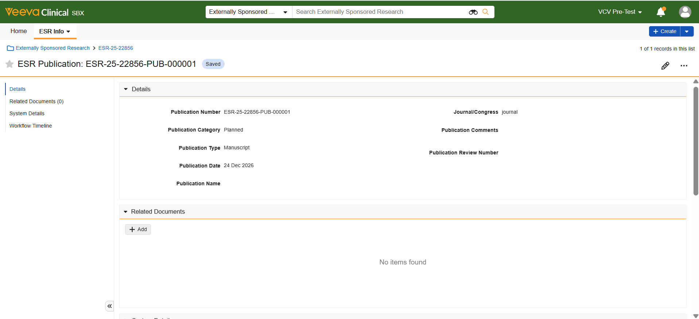

VCV Walkthrough - How to create an ESR study proposal
Uploading the Publication document
20
Click the Publication Number to open the record details
The ‘Related Documents’ subsection has appeared within the record, where publication documents should be uploaded and classified according to the Publication Type as “Publications” or “Final Study Report”.
21
To upload publication documents, open the Related Documents sub-section and click +Add
For more information, see Appendix → How to upload a document

Slide 22
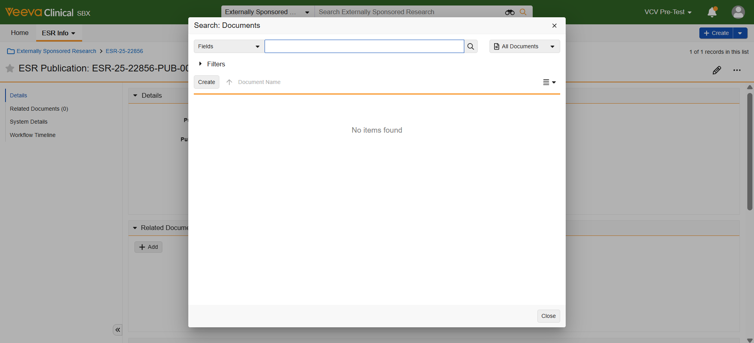

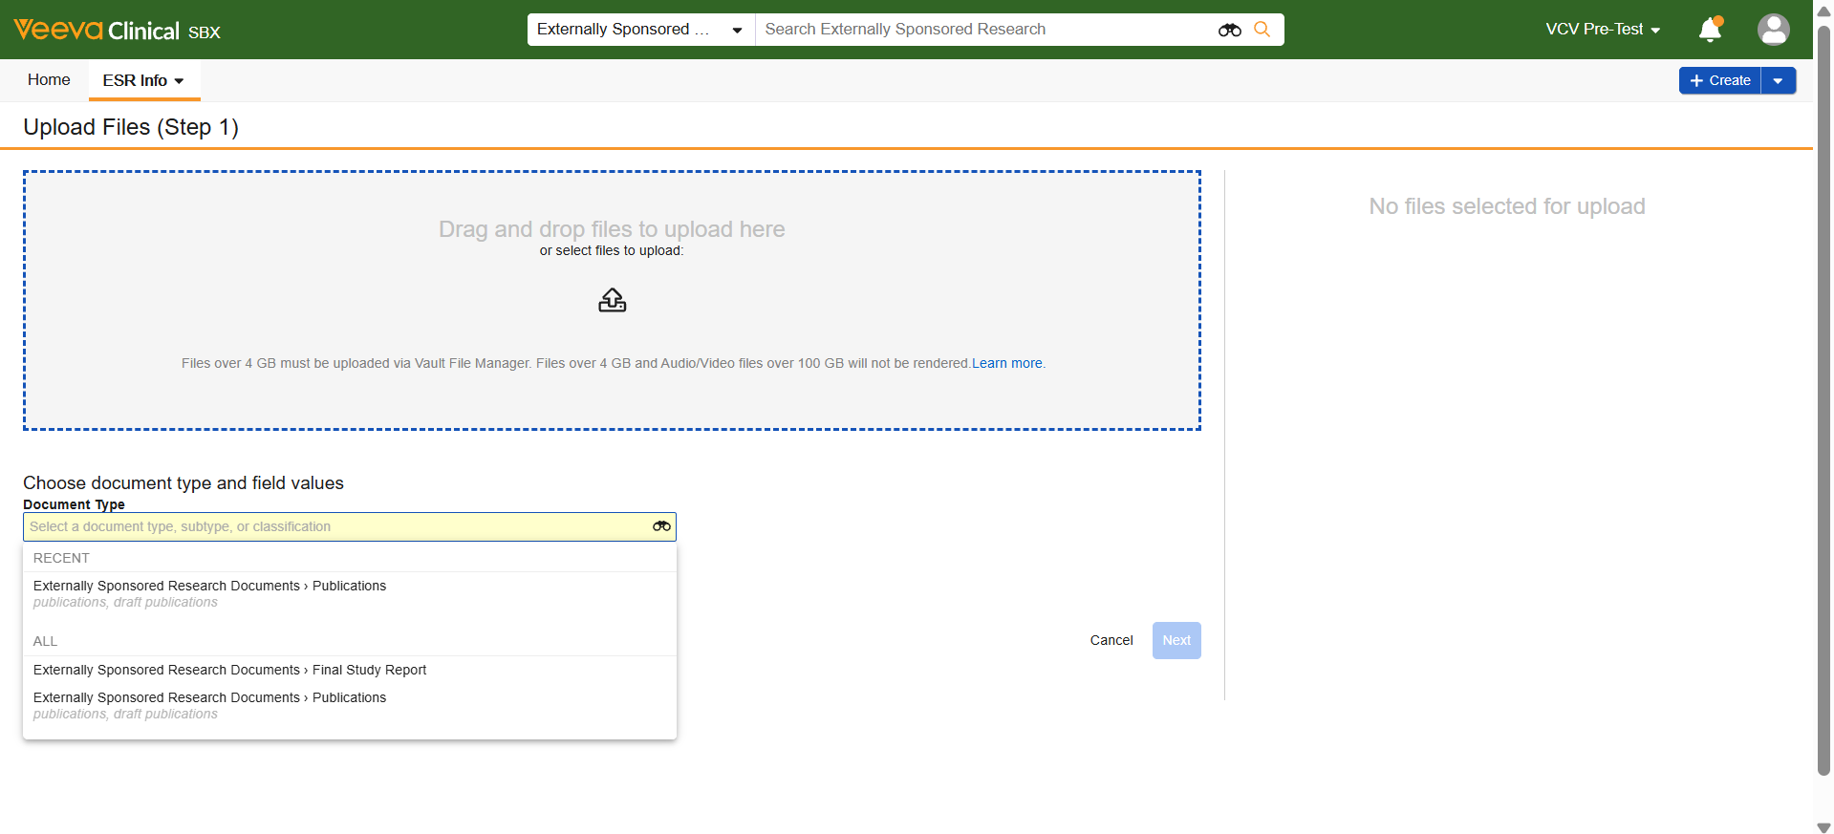
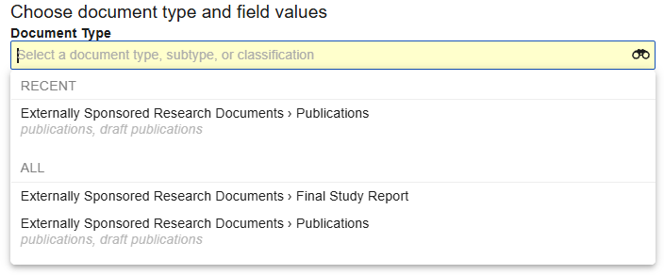
VCV Walkthrough - How to create an ESR study proposal
Uploading the Publication document
A pop-up window appears: Search: Documents.
22
Click +Create
A new window appears:
Upload Files (Step 1).
23
Follow instructions to upload files.
Click on the Document Type field and select the proper Type and Subtype from the drop-down menu

Slide 23
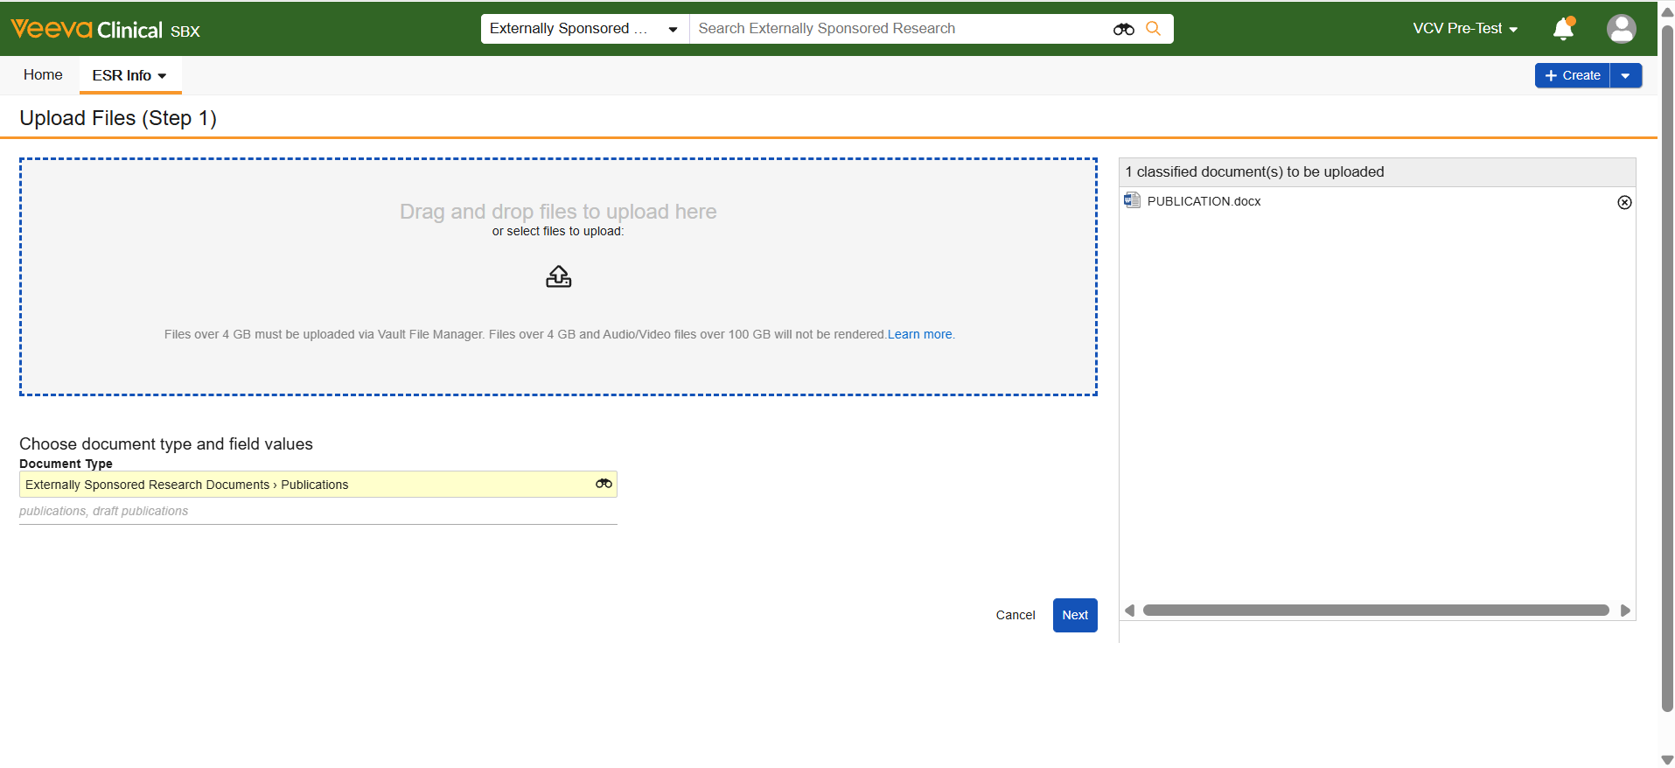

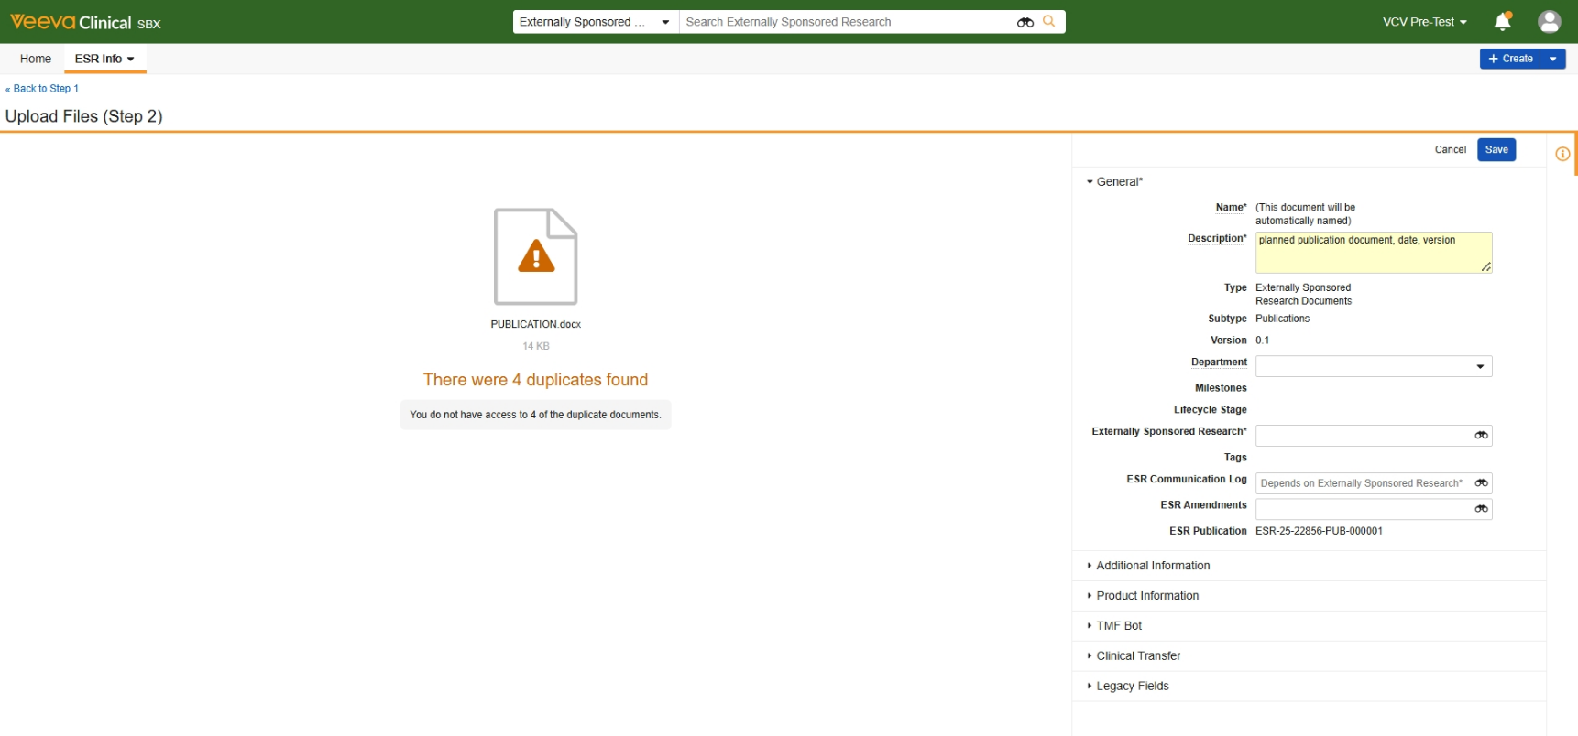
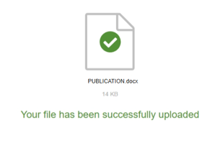

VCV Walkthrough - How to create an ESR study proposal
Uploading the Publication document
24
Click Next
A new window appears:
Upload Files (Step 2).
25
Please enter an appropriate description, including the document’s name and date, if applicable
26
Link ESR Number for your study in the ‘Externally Sponsored Research’ field

Slide 24



VCV Walkthrough - How to create an ESR study proposal
Uploading the Publication document
27
Click Save
The uploaded file appears in the Related Documents sub-section. It is attached to a specific publication record, and it is also visible in the study’s Related Documents section.

Slide 25



VCV Walkthrough - How to create an ESR study proposal
Primary Investigator & Site Information section
28
Open the Primary Investigator & Site Information section and click on the pencil icon
29
Click the Primary Investigator (External) field and select +Create ESR Site Person from the dropdown menu

Slide 26




VCV Walkthrough - How to create an ESR study proposal
Primary Investigator & Site Information section
A pop-up window appears: Create ESR Site Person.
30
Enter the information required for the Primary Investigator
Please note: If the selected Country is United States of America, new mandatory* fields will appear.
31
Click Save
Follow the same steps to add Primary Site (External).

Slide 27






VCV Walkthrough - How to create an ESR study proposal
Primary Investigator & Site Information section
Added Primary Investigator and Site records appear in their fields within the Primary Investigator & Site Information section but remain in edit mode.
Remember to Save the records from the Study view.
32
Click Save
Added Primary Investigator with assigned person number shows up in the Site Personnel section.
Added Primary Site with assigned site number shows up in the Sites section.
Additional personnel and/or site may be added at any time during the study.
27

Slide 28



VCV Walkthrough - How to create an ESR study proposal
Site Personnel and Sites sections
33
Open the Sites section and click +Create
A pop-up window appears:
Create ESR Site.
Please note: If the selected Country is United States of America, new mandatory* field will appear.
34
Complete the mandatory fields and click Save
Follow the same steps to add further Personnel (see Create ESR Site Person)

Slide 29




VCV Walkthrough - How to create an ESR study proposal
Related Documents section
35
To upload a document (PI CV, Budget, Study Design), open the Related Documents section and click +Add
A pop-up window appears: Search: Documents.
36
Click +Create
For more information, see Appendix → How to upload a document

Slide 30



VCV Walkthrough - How to create an ESR study proposal
Related Documents section
A new window appears:
Upload Files (Step 1).
37
Follow instructions to upload files.
Click on the Document Type field and select the proper Type and Subtype from the drop-down menu
38
Click Next

Slide 31



VCV Walkthrough - How to create an ESR study proposal
Related Documents section
A new window appears:
Upload Files (Step 2).
39
Please enter an appropriate description, including the document’s name and date, if applicable
40
Click Save
The uploaded document appears the Related Documents section.

Slide 32



VCV Walkthrough - How to create an ESR study proposal
Submission Checklist section
41
Open the Submission Checklist section, review the listed requirements and verify whether they have been completed
Before the proposal is submitted for review, it is essential to:
Upload Primary Investigator CV
Provide at least one Planned Publication
Upload Budget (if funding is requested)
Upload Study Design template (for Oncology and Immuno-Oncology studies)
42
Click the pencil icon and tick the boxes from the checklist
Click Save

Slide 33





VCV Walkthrough - How to create an ESR study proposal
Submit proposal
43
Click on the Workflow icon top right and select Submit Proposal from the drop-down menu
A pop-up box appears:
Start.
44
Follow the instructions and click Start
Allow >1 minute for system to process the submission.

Slide 34





VCV Walkthrough - How to create an ESR study proposal
Submit proposal
Please note: If any mandatory fields are left incomplete, a pop-up box will appear listing the fields that need to be filled in.
45
Review the list of missing information, click OK and fill in the required fields. Repeat step 31 to submit the proposal
Once the submission is successfully completed, the study's lifecycle changes to Proposal in Review.
After you have submitted the proposal, responsibility for next steps lies with AZ team. AstraZeneca may accept or decline the study proposal or request additional information.
The system will notify you via email regardless of the decision.

Slide 35
for a Proposal/Protocol Quality Check (QC), Local Proposal Review or (HQ) Proposal/Protocol Review
2
How to provide Additional Information Requested
Click the link to see the training video, How to provide additional information requested
Return to Contents

Slide 36





VCV Walkthrough - How to provide Additional Information Requested
for a Proposal/Protocol QC, Local Proposal/Protocol Review or (HQ) Proposal/Protocol Review
If the Verdict of the QC or review is Additional Information Requested, a new task will appear for the External User: Add Info Requested Proposal/Protocol QC, Local Proposal/Protocol Review or (HQ) Proposal/Protocol Review with Due Date and Instructions.
Lifecycle of the study changes to Additional Information Requested.
1
Click Accept and follow instructions shared by AstraZeneca
Please note: Additional comments/instructions may be sent to you via the Communication log or via email.
2
Provide Additional Information as requested and click Complete
Once the Add Info Requested task is completed, responsibility for next steps lies with AstraZeneca. AZ team may either accept the information provided or request additional information. The system will notify you via email regardless of the decision.

Slide 37
How to submit a Protocol
3
Click the link to see the training video, How to submit a protocol
Return to Contents

Slide 38




VCV Walkthrough - How to submit a Protocol
Protocol submission
When Study’s lifecycle shows as Proposal Approved, the Protocol may be submitted for QC and Review.
1
Upload the Protocol in the Related Documents section (see Appendix $→$ How to upload a document)
Protocol should be uploaded under the document subtype: Initial Protocol.
2
To submit the Protocol, click on the Workflow icon and select Submit Protocol from the drop-down menu

Slide 39



VCV Walkthrough - How to submit a Protocol
Protocol submission
A pop-up box appears:
Start.
Upon submitting a Protocol for Oncology/Immuno-oncology studies, external user is prompted to confirm that updated Study Design document has been uploaded, if the design has changed since the last upload. The system will also require a confirmation during Protocol Amendment creation (See → How to create an Amendment).
3
ONC
Select ‘Yes’ to confirm that current Study Design document has been uploaded and click Start
Lifecycle of the study changes to
Protocol in Review.
After you have submitted the initial protocol, responsibility for next steps lies with AstraZeneca. AstraZeneca may either accept the provided protocol or request additional information.
The system will notify you via email regardless of the decision.
ONC
Step completed for Oncology/Immunooncology ESRs

Slide 40
How to provide a Project Status Update (PSU)
4
Click the link to see the training video, How to provide a project status update
Return to Contents

Slide 41


VCV Walkthrough - How to provide a Project Status Update
As per the terms outlined in the contract, the Sponsor is required to provide Project Status Updates. Project Status Updates section is available after a Contract is signed and executed. Reminders are sent to the Sponsor to improve PSU submission timelines.
Additionally, Local Coordinator can request PSUs ad hoc at any time during the study. In such cases, the task PSU Requested with Due Date appears in the taskbar.
1
Click Accept
2
To create a PSU record, go to the Project Status Updates section and click +Create
Please note: Only one PSU can be created per day.

Slide 42



VCV Walkthrough - How to provide a Project Status Update
PSU creation
New window appears:
Create ESR Project Status Update.
To support Sponsors through the Project Status Update creation and submission process, there are additional Help sections with step-by-step instructions tailored to each PSU state (Creation, Submission, Milestone Update, Review and Resubmission).
3
Answer the Yes/No questions to choose which sections you want to update
Updates may consist of: Milestones, Subject Enrollment, Safety Reporting, Planned Publications and/or Regulatory Updates.

Slide 43



VCV Walkthrough - How to provide a Project Status Update
PSU creation
4
Click Save
Status of the created PSU record is Saved.
Depending on the answers provided in the first sub-section, further sub-sections appear with mandatory fields to complete before PSU submission.
Follow instructions in the Help Section – Saved to complete the PSU record and submit it for review.

Slide 44





VCV Walkthrough - How to provide a Project Status Update
Yearly Interim Line Listing
As per research agreement, the Sponsor is required to send AZ yearly interim reconciliations. For studies in which the ‘First Study Subject In’ Actual date is over 1 year before the current date (PSU record creation date), a field: "Yearly Line Listing Submitted Date“ appears to provide visibility on when was the last Sponsor’s submission of the Line Listing of all safety events notified to the Company and if it should be updated.
5
Click the pencil icon to edit the field
6
Provide the Yearly Line Listing Submitted Date
Click Save

Slide 45



VCV Walkthrough - How to provide a Project Status Update
Milestone Update
If the answer to: Are there Milestone Updates? was 'Yes’, the Milestone Update sub-section shows up, where the milestone(s) selected for update should be added.
It is required to add at least one Milestone in this section.
7
Open the Milestone Update sub-section and click +Add
A pop-up box appears: Search ESR Milestone with all milestones that are set up for this Study.
8
Check the box next to the Milestone(s) you wish to update and click OK

Slide 46


VCV Walkthrough - How to provide a Project Status Update
Milestone Update
Selected milestone(s) will appear in the Milestone Update sub-section.
9
To update the Milestone, click the blue-linked Milestone Name
10
Go to the Updates to Milestone sub-section
and click the pencil icon to edit the fields
Follow instructions in the Help Section to provide the milestone update.

Slide 47





VCV Walkthrough - How to provide a Project Status Update
Updates to Milestone - Planned Finish Date
11
If the Planned Finish Date needs to be changed, add a new date in the ‘Updated Date’ field
12
Fill in the Reason for Change field by selecting a cause of the milestone delay from the picklist
If none of the listed values apply and ‘Other’ is selected, new mandatory field appears: If ‘Other’, reason for change, where the reason for the milestone change should be specified.

Slide 48
VCV Walkthrough - How to provide a Project Status Update
Updates to Milestone – Actual Finish Date
13
If you are providing the Actual Finish Date, check the ‘Milestone is achieved’ box
14
Enter the date of milestone achievement in the ‘Updated date’ field
15
Fill in the Reason for Change field by selecting ‘Milestone achieved’ from the picklist

Slide 49


VCV Walkthrough - How to provide a Project Status Update
Updates to Milestone
16
Click Save
17
Navigate back to the PSU record by clicking the blue-linked PSU Number
Repeat steps 9 – 16 for each milestone selected for update.

Slide 50




VCV Walkthrough - How to provide a Project Status Update
Subject Enrollment Update
If the answer to: Are there updates to Subject Numbers? was 'Yes', the Subject Enrollment Update sub-section appears, containing values provided in the Study Information section.
18
Open the Subject Enrollment Update sub-section and click pencil icon to edit the fields
19
Enter updated number of subjects in the appropriate fields in the right-hand column
20
Proceed to the next sub-section if available. If not, click Save

Slide 51


VCV Walkthrough - How to provide a Project Status Update
Serious Adverse Event/Adverse Event Information Update
If the answer to: Is there any SAE/AE Information Update? was 'Yes', the SAE/AE Information Update sub-section appears with mandatory field:
‘I confirm the SAE/AE has been reported’.
21
Open the SAE/AE Information Update sub-section and check ‘Yes’ to confirm that the SAEs/AEs have been reported to the AZ Company
22
Proceed to the next sub-section if available.
If not, click Save.

Slide 52



VCV Walkthrough - How to provide a Project Status Update
Publication Plans Update
If the answer to: Are you planning any study publications? was 'Yes', the Publication Plans Update sub-section appears.
Please ensure the updates entered in this sub-section are reflected in the Publication node.
23
Open the Publication Plans Update sub-section and provide the likely timing and publication details
Please provide the publication type, approximate planned publication date, and the name of the journal/congress where it's planned to be published.
24
Proceed to the next sub-section if available.
If not, click Save

Slide 53



VCV Walkthrough - How to provide a Project Status Update
Regulatory Update
If the answer to: Are there Regulatory Updates?
was ‘Yes’, the Regulatory Update sub-section appears with two fields: IRB/EC Approval Date and IRB/EC Expiration Date.
25
Open the Regulatory Update sub-section and update the IRB/EC Approval and/or Expiration Date.
26
Click Save

Slide 54


VCV Walkthrough - How to provide a Project Status Update
After clicking Save, all provided updates will be saved under their corresponding sub-sections within the PSU record.
27
Click the blue-linked ESR Number to go back to the Study view
Created PSU record shows up in the Project Status Updates section.
28
Complete the task PSU Requested by clicking Complete

Slide 55




VCV Walkthrough - How to provide a Project Status Update
A pop-up box appears: PSU Requested.
29
Click Complete
Once PSU requested fields are completed and the record was saved, the Investigator should submit PSU for AZ review.
30
Go to the Project Status Updates section and click the blue-linked PSU Number

Slide 56





VCV Walkthrough - How to provide a Project Status Update
PSU Submission
When PSU has not been submitted for 48 hours and remains in 'Saved’ state, the Investigator will be notified via email about Pending submission.
31
To submit PSU, click the workflow icon and select ‘Submit PSU’ from the dropdown menu
A pop-up box appears: Start.
32
Click Start to proceed with the submission and send PSU for review

Slide 57





VCV Walkthrough - How to provide a Project Status Update
PSU Review
PSU Status changes to In Review.
External users cannot edit the record in review state.
Local Coordinator reviews the PSU. Depending on the review outcome, further tasks may be generated.
A notification with the review verdict and comments will be sent via email once the review is completed.
If the Verdict is ‘Review and Resubmit’, the task PSU sent for review and resubmit with Instructions appears under the PSU record.
PSU status has changed to Review and Resubmit.
Follow instructions in the Help Section–Review and Resubmit to provide requested update and resubmit PSU.

Slide 58



VCV Walkthrough - How to provide a Project Status Update
PSU sent for review and resubmit
33
Click Accept and follow comments from AZ reviewers to update the PSU
34
Click the pencil icon to edit the fields and make requested changes
Additional instructions may be sent to you via the Communication Log.

Slide 59




VCV Walkthrough - How to provide a Project Status Update
PSU sent for review and resubmit
35
Once all the updates are complete, click Save
36
Complete the task by clicking Complete
A pop-up box appears: PSU sent for review and resubmit.
37
Click Complete

Slide 60





VCV Walkthrough - How to provide a Project Status Update
PSU Resubmission
38
Click the workflow icon and select ‘Resubmit’ from the dropdown menu
A pop-up box appears: Start.
39
Click Start to proceed with PSU resubmission

Slide 61


VCV Walkthrough - How to provide a Project Status Update
Project Status Update Accepted
Status of the PSU record goes back to In Review.
If the Verdict is Review and Resubmit, repeat the steps 33 - 39.
If a verdict of the AZ review is Accept, PSU status changes to Accepted. Some of the updates will automatically replace the information that was previously provided in the respective sections of the Study.
If there were updates to Milestones, they will be copied over to the Milestones section.
If there were updates to Subject numbers, they will be copied over to the Study Information section.
If there were updates to Regulatory dates, they will be copied over to the Regulatory Identifiers se

Slide 62
How to create an Amendment
5
Click the link to see the training video, How to create and submit an amendment
Return to Contents

Slide 63



VCV Walkthrough - How to create an Amendment
An Amendment can be created for an ESR Study at any time once the Study Protocol has been quality checked and reviewed by AZ team with an Approved verdict.
1
Open the Amendments section and click +Create
A pop-up window appears:
Create ESR Amendment.
2
Select the Amendment Type and provide the Description of Change. If the type is ‘Revised budget’, you can add the amount in the ‘Amendment Amount’ field

Slide 64





VCV Walkthrough - How to create an Amendment
If the Amendment Type is ‘Revised Protocol’, a mandatory field ‘Are there changes in the Study Design?’ will appear to confirm whether the Sponsor has uploaded an updated Study Design document based on the protocol changes. This requirement applies to studies with TA = Oncology and Immuno-oncology.
3
ONC
Answer the question by selecting ‘Yes’ or ‘No’
If the answer is ‘Yes’, a new field appears:
I confirm the Study Design is up to date.
4
ONC
Select ‘Yes’ to confirm that the updated Study Design document has been uploaded in the Related Documents section and click Save
ONC
Step completed for Oncology/Immunooncology ESRs

Slide 65







VCV Walkthrough - How to create an Amendment
Created Amendment record shows up in the Amendments section. The lifecycle state of this record is ‘Submitted’, which means AstraZeneca reviewers have been notified that new amendment was created and is ready for their review.
5
Click on the Amendment Number
The ‘Related Documents’ subsection appears within the record, where you should upload ‘Protocol Amendment’, ‘Budget’ or ‘Regulatory’ type document directly after the amendment record is created.
6
Click +Add and follow steps from the Appendix $→$ How to upload a document

Slide 66



VCV Walkthrough - How to create an Amendment
Uploading the Amendment document
The added file appears in the Related Documents sub-section. It is attached to a specific amendment record and it’s not visible in the study’s Related Documents section.
To display the document in the study level Related Documents section, link ESR Number for your study in the ‘Externally Sponsored Research’ field when uploading a file under ‘Related Documents’ sub-section in the amendment record​.

Slide 67



VCV Walkthrough - How to create an Amendment
Additional Information Requested for Amendment
AstraZeneca reviews the amendment. Once the review is completed, you will be notified of the verdict and informed of any other tasks you need to perform. Additional instructions may be provided to you via the Communication Log.
If If the Verdict is Additional Information Requested, Additional Info Requested for Amendment with Due Date and Instructions appears in the taskbar.
7
Click Accept, provide Additional Information and upload the updated document if required
8
Click Complete
Please note: The task is visible only after opening a specific Amendment Record.

Slide 68

VCV Walkthrough - How to create an Amendment
Additional Information Requested for Amendment
A pop-up box appears: Additional Info Requested for Amendment.
9
Click Complete
After you have completed the Additional Info Requested task, responsibility for next steps lies with AstraZeneca. AstraZeneca may either accept the information provided or request additional information. The system will notify you via email regardless of the decision.

Slide 69




VCV Walkthrough - How to create an Amendment
If the Verdict of the Amendment Review is Approved, the Amendment shows as Approved in the Amendment record.
If the Verdict of the Amendment Review is Declined, the Amendment shows as Declined in the Amendment record.

Slide 70
How to provide Final Deliverables
6
Click the link to see the training video, How to provide final deliverables
Return to Contents

Slide 71




VCV Walkthrough - How to provide Final Deliverables
If When a lifecycle of the study is Closing, a task appears in the taskbar for the Investigator: Final Deliverables Requested with Due Date and Instructions.
1
Click Accept
To upload a document, see Appendix $→$ How to upload a document
2
Follow the instructions shared by AstraZeneca and provide the requested information. Click Complete

Slide 72

VCV Walkthrough - How to provide Final Deliverables
A pop-up box appears: Final Deliverables Requested.
3
Click Complete

Slide 73


VCV Walkthrough - How to provide Final Deliverables
Final Deliverables: Additional Information Requested
The Local Coordinator will receive the Final Deliverables.
If a Verdict of the review is Additional Information Requested, a task appears in the taskbar for the Investigator: Add Info Requested/Final Deliverables with Due Date and Instructions.
4
Click Accept
5
Follow the instructions shared by AstraZeneca and provide the requested information. Click Complete

Slide 74

VCV Walkthrough - How to provide Final Deliverables
Final Deliverables: Additional Information Requested
A pop-up window appears:
Add Info Requested/Final Deliverables.
6
Click Complete

Slide 75


VCV Walkthrough - How to provide Final Deliverables
Whenever the study is ready to be closed, the Local Coordinator selects Close study from the workflow icon dropdown menu and the lifecycle state of the study changes to Closed.
Investigators will be notified of the study's closure.

Slide 76
How to upload a document
7
Return to Contents

Slide 77



VCV Walkthrough - How to upload a document
Related Documents
1
To upload a document for an ESR study, go to the Related Documents section and click +Add
A pop-up box appears: Search: Documents.
The box shows a list of documents the user previously uploaded to VCV, along with those from studies the user is assigned to. From this view, multiple documents can be attached to one study.
2
Click Create to upload a new document

Slide 78




VCV Walkthrough - How to upload a document
Related Documents
If Create is selected, a new window appears:
Upload Files (Step 1).
3
Follow instructions to upload files.
Click on the Document Type field and select the proper Type and Subtype from the drop-down menu
Please note: A document cannot be created in VCV without uploading a file and selecting Document Type.
The ‘Next’ button will become active only after the document is uploaded and its type is selected.
4
Click Next

Slide 79




VCV Walkthrough - How to upload a document
Related Documents
A new window appears:
Upload Files (Step 2).
If the document is uploaded properly, “Your file has been successfully uploaded” information shows up.
If uploaded file already exists in the system, “There were duplicates found” will appear.
5
Please enter an appropriate description, including the document’s name and date, if applicable.
6
Click Save

Slide 80




VCV Walkthrough - How to upload a document
Related Documents
Added document appears in the Related Documents section.
7
Click the document Name to open the window with detailed record view, where further actions can be taken
From the record view all information related to a specific document is displayed in the right-hand panel.
Clicking 3 dots icon top right will display a list of actions that can be performed for the document record.

Slide 81




VCV Walkthrough - How to upload a document
Document Soft Delete
8
To delete a document, click on the Workflow icon and select Soft Delete from the drop-down menu
Please note: External users can ONLY delete their own documents.
A pop-up box appears: Start Workflow.
9
Complete the mandatory fields and click Start
After performing Soft Delete, the document is not visible under the Related Documents section for external user.

Slide 82
Any questions? If you have any questions about VCV or your ESR, please contact the AstraZeneca Local Coordinator for your study.
8
Return to Contents

Slide 83
Version History – How to create and manage an ESR study in VCV
Version | Date | Description of change | Author
0.1 | 13.06.2024 | How to create and manage an ESR study in VCV | Paulina Kabaj
0.2 | 03.07.2024 | How to create and manage an ESR study in VCV | Paulina Kabaj
0.3 | 05.07.2024 | How to create and manage an ESR study in VCV | Paulina Kabaj
0.4 | 12.08.2024 | How to create and manage an ESR study in VCV | Paulina Kabaj Maja Żuk
0.5 | 05.05.2025 | How to create and manage an ESR study in VCV | Paulina Kabaj Maja Żuk

